Slide 1
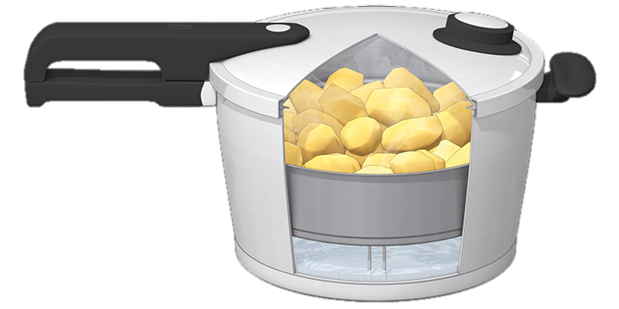
Faith in the Pressure Cooker
Faith
The Letter Of James

Slide 2
The pressure cooker
The pressure cooker is the place where things get done quickly
It’s where you feel the impact of every decision and you don’t have the luxury of time
It’s where the difference between undercooked, perfect and overcooked is measured in seconds and blowing a gasket can happen often

Slide 3
God uses James
To bring calm to the pressurised
A listening ear into a noisy shouting match
An demonstration of equality when favouritism is seen
A call to consistency when words and deeds don’t agree
A taming of the tongue when hurtful words are used
A wisdom beyond our own when we run out
A sense of peace and humility to calm anger and frustration
Where serving is a way of life and not just an action to get what we want

Slide 4
James
James was written to scattered and isolated Christian people
James was written by James!
The evidence points to ‘the Lord’s brother’
James’ letter was not popular in the early church
James’ letter has been used to undermine ‘salvation by faith’
James writes so that we can see that Jesus’ sacrifice makes a difference in us in the world
James writes to help
He’s writing to fellow Christians to encourage them in their struggle in life

Slide 5
God wants you to overcome
James’ legacy is this letter
James wants us to know that no trial is outside God’s loving purpose
His letter has over 20 correlations with the Sermon on the Mount
If you do this well maybe you can write a legacy

Slide 6
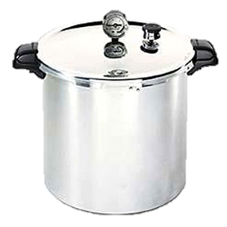

Slide 7
Faith

