Slide 1
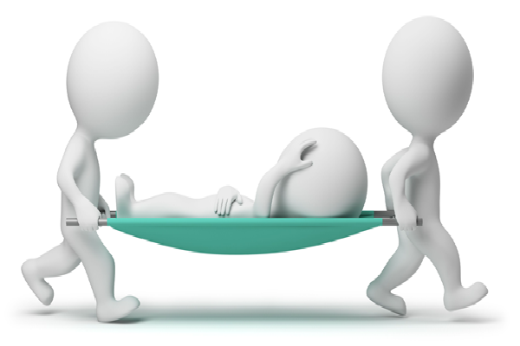
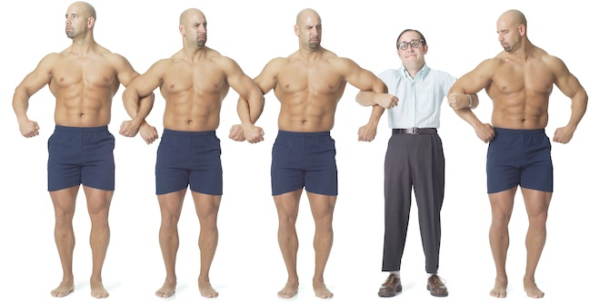
Walking through treacle
8. Minister in brokenness
2 Corinthians 5:20-6:12

Slide 2
Holding standards
Many Christians believe that they can only serve in the church if they are living a reasonably Christian life
Many others betray this as their view when they face a difficulty
This passage says there’s another perspective
Grace is the way…
Pride and grace cannot exist in the same space

Slide 3
God’s kingdom is about you receiving
You received God’s favour
You received God’s salvation
He is the God of GRACE
Salvation starts with Him
Salvation belongs to Him
This is where Paul started the Corinthians on the journey of faith in Christ
Paul’s description of life tells us he was expecting no favours from God because He decided to follow Jesus
This is the mindset of those sold-out to follow Jesus

Slide 4
God wants intimacy with you
His desire is for you and Him to walk through life and eternity together
Getting there is a one-way process
Relying on the rescue and grace of God
You take on His values
You conform to His glory & His righteousness
You take on His priorities
You become part of His kingdom
Once you get that straight life becomes simpler
Without this mindset you will not understand 6:3-10

Slide 5
God’s servants are His fellow-workers
Servants are not God’s equal
We are those who join in with the work of God

Slide 6
Servants of God
Don’t wait until they are perfect before they serve
Rely on God’s grace
Serve in brokenness
Serve because they have received

