Slide 1
Everyone has something to offer
Building the church in the 21st Century

Slide 2
God made you unique
You are unique
Be LIKE Jesus in
His relationship with God
His character
His attitudes and values
With a unique contribution to make
Depending on your character, your giftings, your season, your opportunities, and your willingness to serve

Slide 3
God made you to work in faith
Faith is sometimes not being totally sure
Your ‘gifting’ is one thing, but your leading and discernment are vital
1 Cor 12 we find the Corinthians getting an answer to a question they sent Paul about spiritual things
They weren’t just asking about spiritual gifts, but about the whole art of spirituality
Rom 12 we are to use our gifts (charismata – graces, favours) according to our faith
There’s no room for arrogance in using any grace from God
Every usage should involve some measure of faith

Slide 4
God’s agenda
It is God’s agenda that matters
That is an act of faith
It’s saying I trust what He is doing, how He is doing it and why He is doing it
It’s also saying I want to be used by God to enable His agenda for me, for my family, for my neighbours, for my friends, for my community, for my country, for His world
God’s agenda works by grace through humility (Rom12;3)

Slide 5
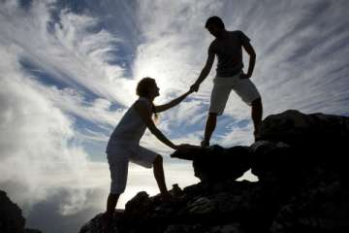
Humility

Slide 6
God’s agenda
It is God’s agenda that matters
That is an act of faith
It’s saying I trust what He is doing, how He is doing it and why He is doing it
It’s also saying I want to be used by God to enable His agenda for me, for my family, for my neighbours, for my friends, for my community, for my country, for His world
God’s agenda works by grace through humility (Rom12;3)
Christians are called to be the living sacrifices that show that a life lived by faith is not wasted, inconsequential or insignificant

Slide 7
God’s measuring stick
A life measured by faith
How does He want me to use what He has given me today?
In work, in words, in silence, in bringing grace and truth to other people

Slide 8
Everyone has something to offer
Each one is responsible hearing what and how much and when

Slide 9
(God inspired)
MATTERS

