Slide 1
Ephesians 3

Slide 2
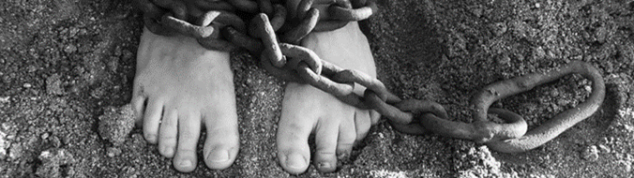
TL;DR
prison
mystery
blessing

Slide 3
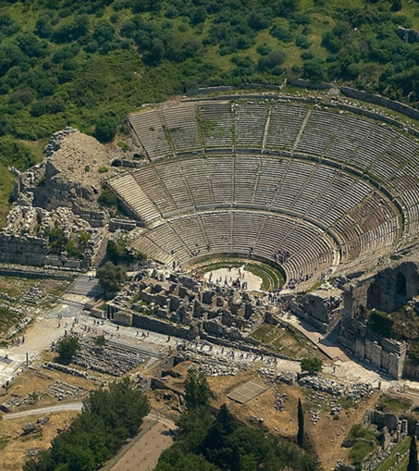
prison
Ephesus theatre
(scene of riot in Acts 19)
“The value we place on something determines the hardship we are willing to endure for it”
(Snodgrass)

Slide 4
mystery
Jewish and non-Jewish people together share the promises God has made

Slide 5
My house will be called a house of prayer for all nations
Isaiah 56:7
(quoted by Jesus in the temple in Mark 11:17)

Slide 6
manifold = multi-faceted
God’s light:
reflected and refracted
revealed and beautiful
colourful and multi-directional

Slide 7
blessing
God’s love is superlative in every dimension
God’s love flows through each of us
(And yes, that is truly astonishing)

Slide 8
