Slide 1
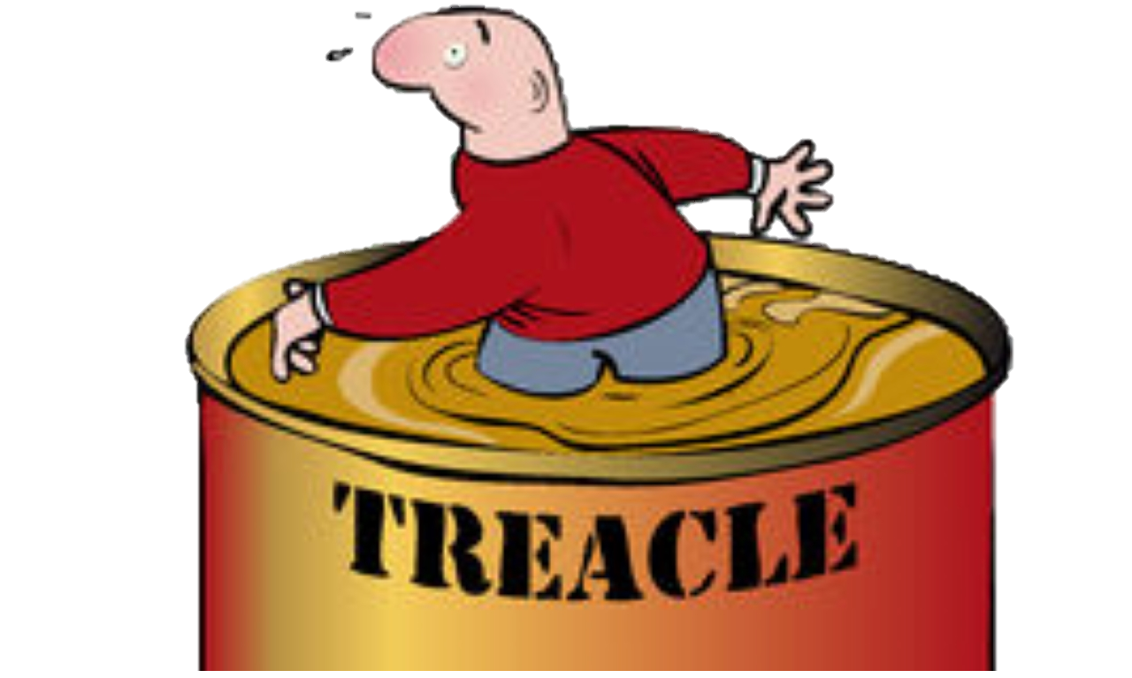
Walking through treacle
10. Use reliable sources
2 Corinthians 7:5-9:15

Slide 2
This section says very little about God, yet it is permeated by His presence
God comforts the downcast (7:6)
God loves a cheerful giver (9:7)
God is able to bless you abundantly (9:8)
God supplies everything (9:10)
In between these statements is an example of how that happens through people

Slide 3
Godly help for maturing Christians
Give them credit for what they have done (8:6)
Notice their other gifts (8:7)
Don’t manipulate with guilt (8:8)
Let them work it out (8:9)
Let them retain the problem (8:10)
Keeps everything in the open to preserve integrity
Using reliable people, letting others check what’s happening

Slide 4
God and giving
The good news is that God has made you rich
The question is ‘What do you want to say with it?’
If you are rich in grace and love you will want the glory and thanks to go to God
You will be a cheerful giver
You will discover God’s economy

