Slide 1
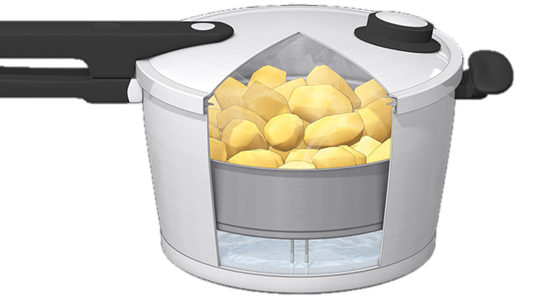
Faith in the Pressure Cooker
The Letter Of James
8 Challenges produce great faith
2:14-26
Faith

Slide 2
Challenges
To faith:
The questioning of motives for what we do and say
The questioning of trust of the Bible

Slide 3
The question of works
Paul has been preaching ‘salvation through works is impossible’
James agrees with this in this letter
Paul has been saying ‘faith is a gift from God’ (Eph 2:8)
So does James (2:5)
Paul has been telling converts ‘faith is a common mark of all Christians’ (Gal 3:26)
So has James (2:1)
Paul has been writing that faith is the continuing reality that runs through all our Christian experiences (1Tim 6:12)
So has James (2:22)
Paul has been teaching that faith is the root from which good works grow (Tit 3:8)
So does James (2:22)
Paul has been preaching ‘Salvation by Faith Alone’
Something that James fundamentally agrees with

Slide 4
The challenge has a context
James is writing to Christians and seeing an error creeping in
Faith without obedience to the leading of the Spirit
The definition of ‘faith’ that James is using is the classic one from his own background and the one Jesus used
‘Beliefs demonstrated through action’
Not universally held by those outside Judaism

Slide 5
Faith defined
Belief alone is ineffectual to people
The hungry are sent away unfed
Summary ‘faith without works is dead’ (17)
Belief alone is ineffectual to God
It gives no peace with God
Summary ‘faith without validating works is barren’ (20)
Genuine faith is effectual to God
You hear the Spirit of God and you act on it
Summary ‘works of obedience to God’s will provide evidence for faith’ (24)
Genuine faith in effectual to people
It shows itself in compassion
Summary ‘works show faith to be a living entity’ (26)

Slide 6
God wants you to understand ‘faith’
Faith transforms EVERYTHING
‘Works’ are your expression of faith
They are the overflow of my belief that Christ died and rose and will return for me
They are the outcome of me being loved and accepted by God

Slide 7
Faith overflowing
The outworking of your faith is seen through your ‘religion’
Your ‘religion’ (1:26) is seen in
How you control your tongue (1:26)
How you treat the poor (1:27)
Your personal holiness in not blending with the world (1:27)
The inworking of your faith is seen in your interactions with God and with people

Slide 8
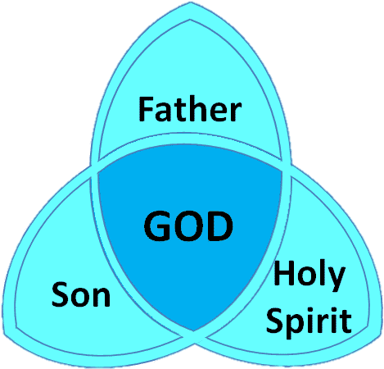
Faith
Faith
Belief
Belief

Slide 9
Challenge
Let your faith shine through engaging with God and with people
Gratitude, Kindness and LOVE

