Slide 1
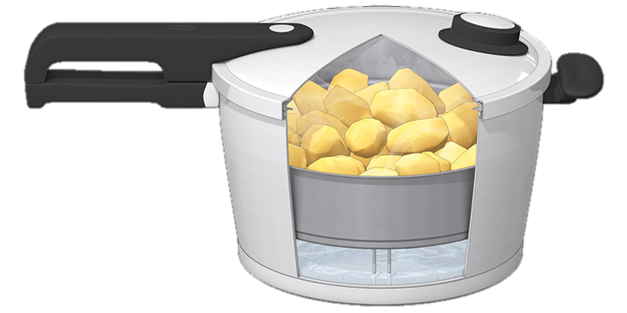
Faith in the Pressure Cooker
The Letter Of James
7 Devotion done right exudes mercy
2:8-13
Faith

Slide 2
The pressure cooker
The pressure cooker is the place where things get done quickly
It’s where you feel the impact of every decision and you don’t have the luxury of time
It’s where the difference between undercooked, perfect and overcooked is measured in seconds and blowing a gasket can happen often

Slide 3
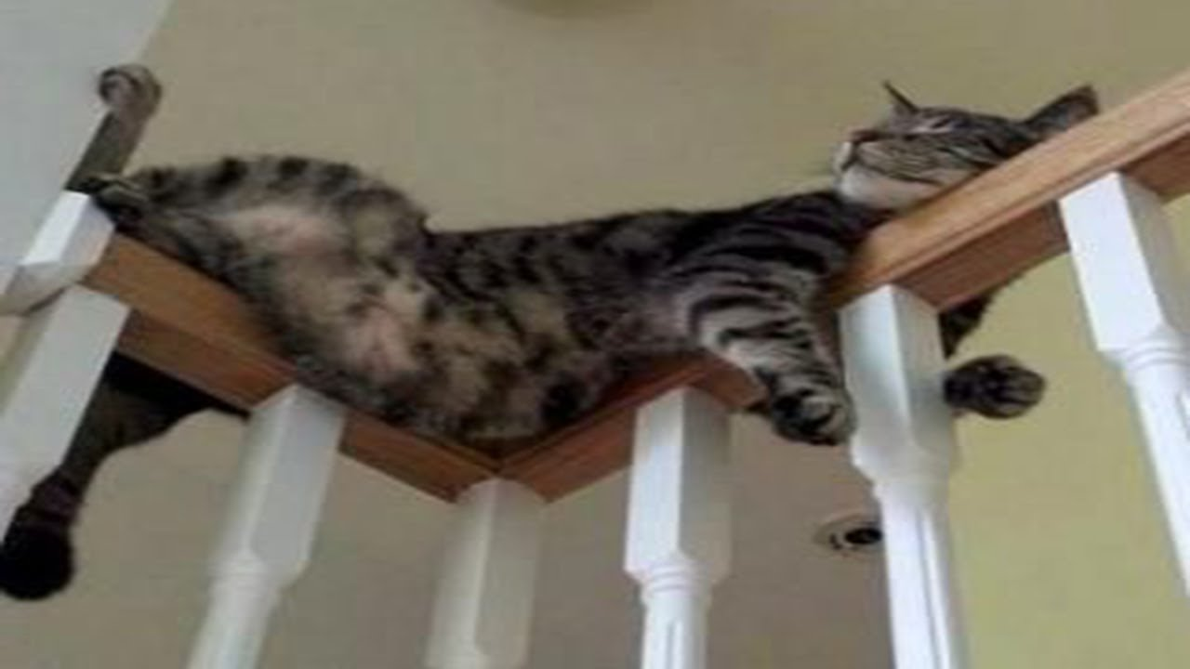
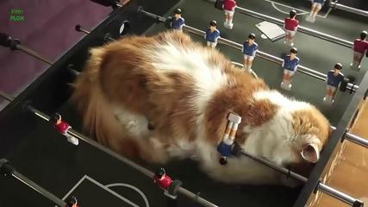
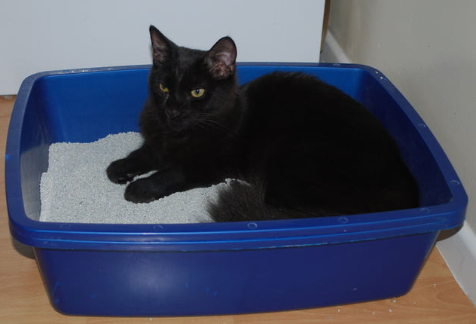
We’re comfortable where we are!
After a while we can get comfortable in the pressure cooker
It can become our safe place
And the idea of coming out of the pressure cooker can fill us with dread
Better the devil you know than the devil you don’t know!
It’s bad, but out there may be worse!
But this is where James kicks in and talks about…

Slide 4
Faith overflowing
James is saying the outworking of your faith is seen through your ‘religion’
Your ‘religion’ (1:26) is seen in
How you control your tongue (1:26)
How you treat the poor (1:27)
Your personal holiness in not blending with the world (1:27)
And it is measured against the faith of Christ (2:2) who taught the Royal Law: Love your neighbour as yourself
Don’t show partiality to the rich BUT don’t show partiality to the poor either
Your partiality does not show the extent of God’s mercy

Slide 5
Love your neighbour as yourself
Treat them as you would want to be treated
This is NOT the most important truth
Jesus taught a higher truth from the OT:
Love God with all your heart, soul and strength (Dt 6:4)
But it is the Royal Decree for those who call Jesus their King
It’s not a new law – it’s from the OT: Lev 19:18
Don’t seek revenge or bear a grudge but… love your neighbour as yourself
However justifiable MERCY covers them

Slide 6
James encourages
James is preaching/writing to people in the real world
He speaks of grace
Offering people what they don’t deserve
He speaks of mercy
NOT giving people what they do deserve
That’s how we are to treat the rich AND the poor
This is the game changer in dealing with other people
And it’s based on what God does for us
He gives us grace through Christ and He covers us with mercy on the journey

Slide 7
Faith

Slide 8
Challenge
To think about steps forward in doing things
If I am to do something old… how will I do it differently to stay safe AND show my faith?

