Slide 1
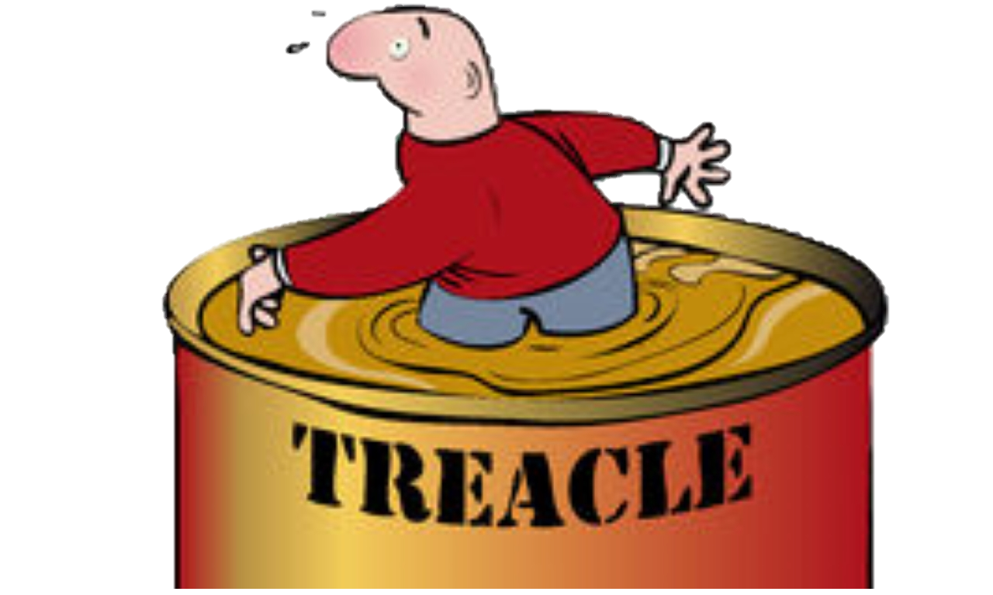
Walking through treacle
6. Look up and see the glory!
2 Corinthians 3:7-4:6

Slide 2
God wants you to have hope
He designed you to function better with hope
When you lose hope you lose your humanity, the image of God in you, your self-esteem, your potential you become a shell of who you really are
Without hope you fall into depression, you lose any vision of the future, your outlook is bleak
The right kind of hope inspires you to work, to invest time and energy, to overcome, to face the difficult path, to undergo severe trials

Slide 3
God offers hope
Hope of a fresh start, forgiveness and life beyond death
This hope is offered in a gracious act followed by a covenant
I’ll rescue you and put you on the right path
The OT gives us the history of the covenant with the Jews
He rescued them in a gracious act from slavery in Egypt
He lead them to Himself at Mount Sinai
He gave them a path to follow and a way to live called the Law
He lead them to the Promised Land
He told them of the promise of eternal life if they keep to the path
But they don’t keep to it, they find they can’t keep to it
God promises them a new covenant (Jeremiah 31:31-34)

Slide 4
God’s new covenant is here
It came through Jesus the Messiah
Believe in Jesus, receive the Holy Spirit and do life as God intended
The veil has been removed!
Paul goes back to Exodus 34:29-35 and Deuteronomy 29:2-4
The veil that Moses used to cover his face
The veil stopped them all seeing the glory of God transforming lives
People would rather have the scriptures than the presence of God
But in Jesus Christ the veil has been taken away
The Holy Spirit, who touched Moses on the mountain and inspired the prophets on occasions, was now living in the saints
Everyone’s face can now shine!

Slide 5
