Slide 1
God with us
Coming as one of us

Slide 2
Advent
A time to celebrate ‘God with Us’
Immanuel
A time to look back at the coming of Christ
The first time as one of us
A time to look forward to the return of Christ

Slide 3
The prophets
He’s coming!
Specifics!
Moses, Isaiah, Jeremiah, Micah, Malachi, etc
As the Jewish writers expected
This was the hope in dark and uncertain times
That God would deal with sin and death and hell and bring, joy, peace, acceptance and hope
That God would deliver grace through the Messiah
John says – I’ve seen it all and I can tell you: Jesus IS the Messiah!

Slide 4
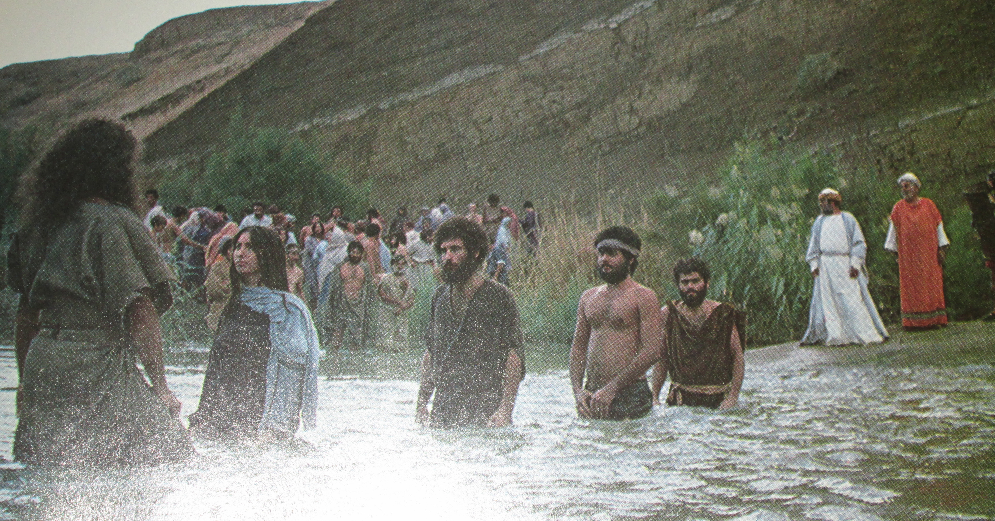
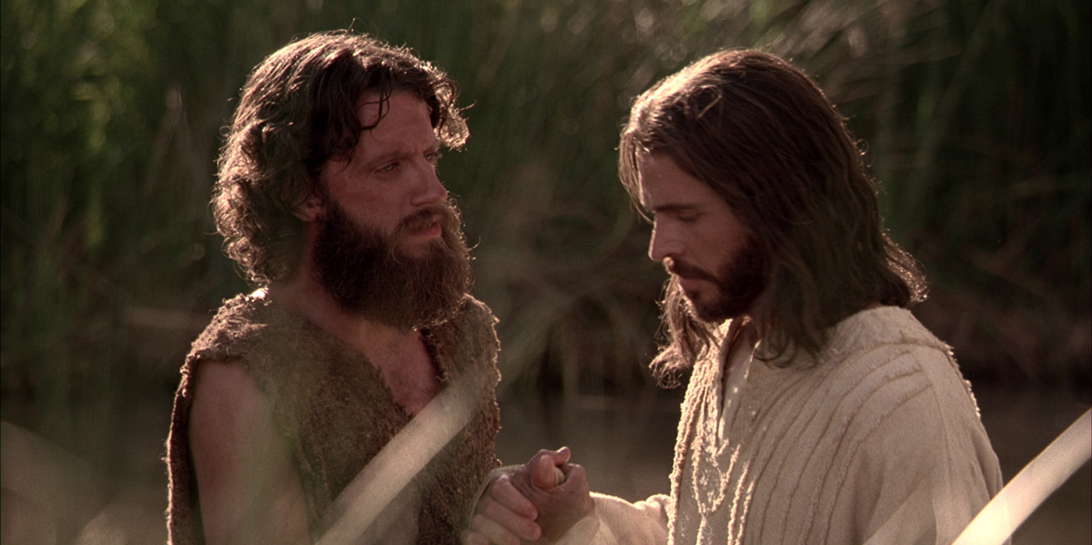
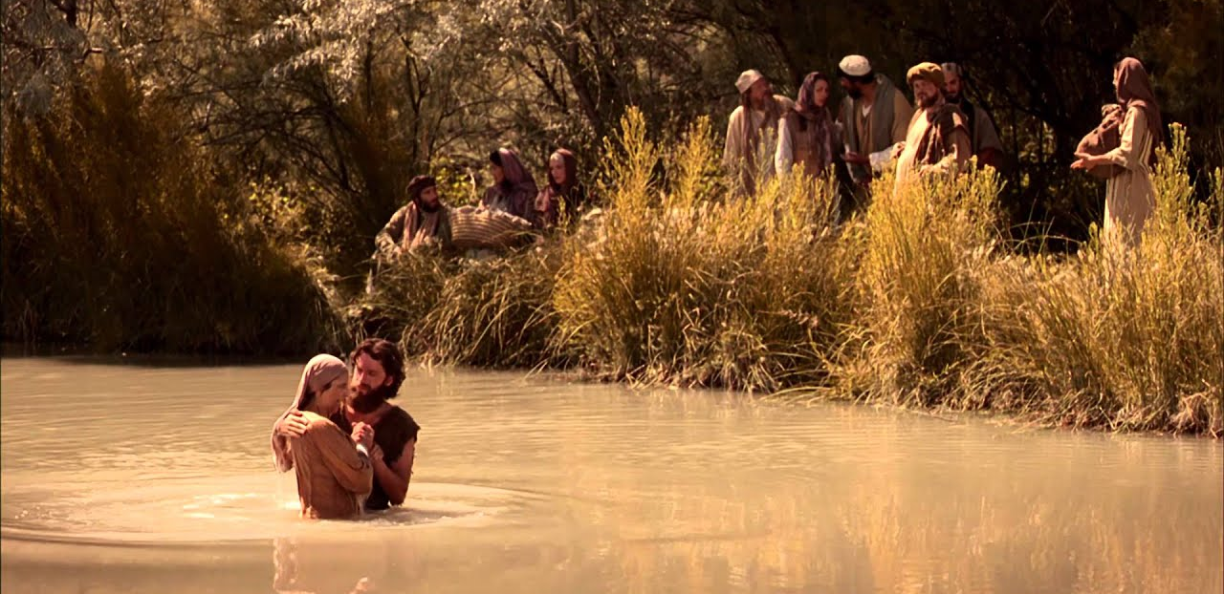
John the Baptist
“He’s here”

Slide 5
Jesus laid it all down for us
He gave up
Omniscience (knowing everything)
Omnipresence (being everywhere)
Omnipotence (being able to do anything)
Complete unity and fellowship in the Godhead
He learned first-hand what it felt like to be us
He did all this to bring us hope

Slide 6
God’s plan for you is demonstrated by Jesus
“This is how you were designed to live”
In union with God
In humility
With a servant heart
With a mission of compassion that brings healing and restoration to all who need it

Slide 7
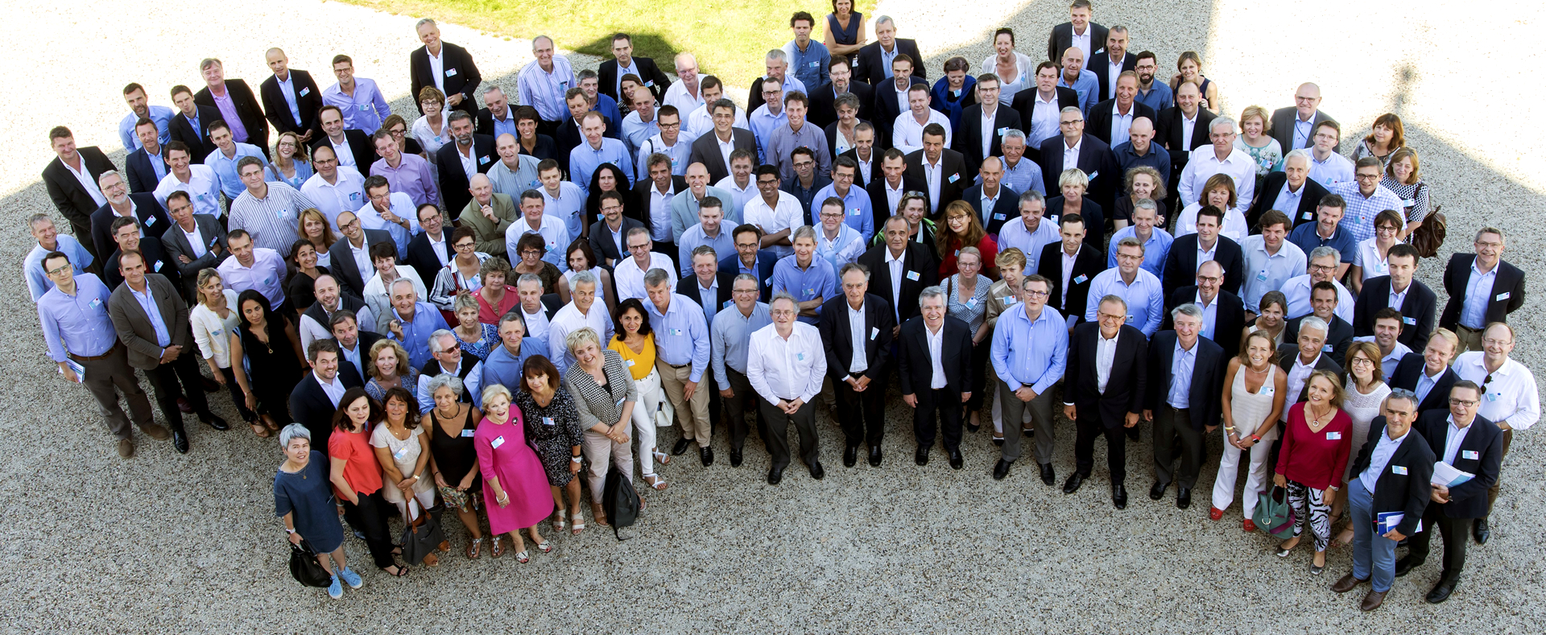
God became one of us so that we might become one with Him in glory

Slide 8
God with us
Coming as promised
Coming as one of us

