Slide 1
What Must I Do?
Part 2
All images taken from Pixabay for free use

Slide 2
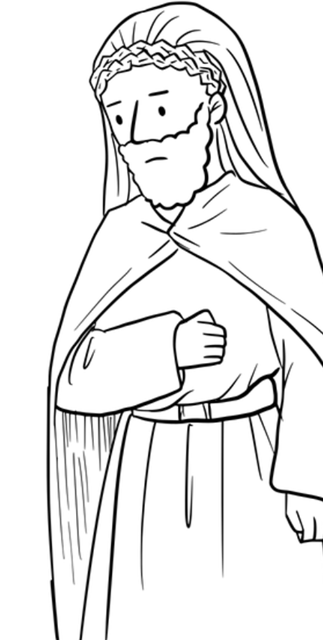
Recap – What Must I Do? Part 1
Luke 10:25-28
What must I do to inherit eternal life?
You can’t – it is God’s grace!
We can respond in love once we experience this – loving God and loving our neighbour

Slide 3
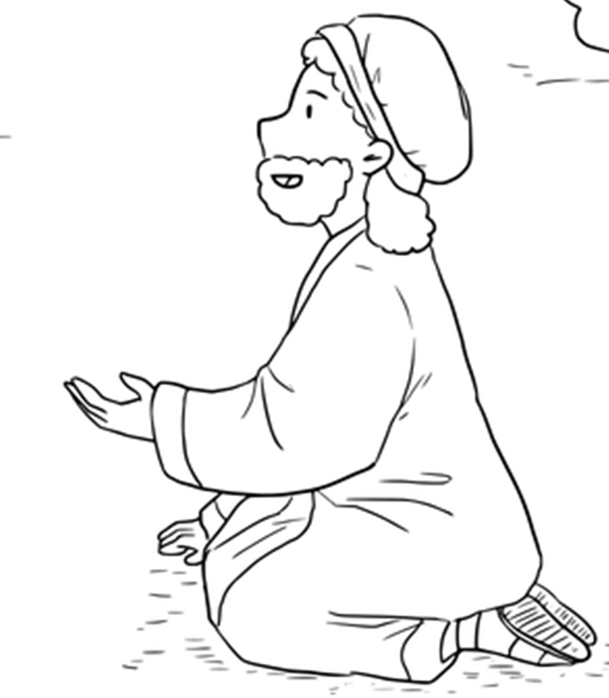
What Must I Do? Part 2
Luke 18:18-30
Parallel accounts in Matthew 19:16-30 and Mark 10:17-31
Straight after the children coming to Jesus in all three accounts
Jesus says that God’s Kingdom belongs to people like children
What Do You Depend On?

Slide 4
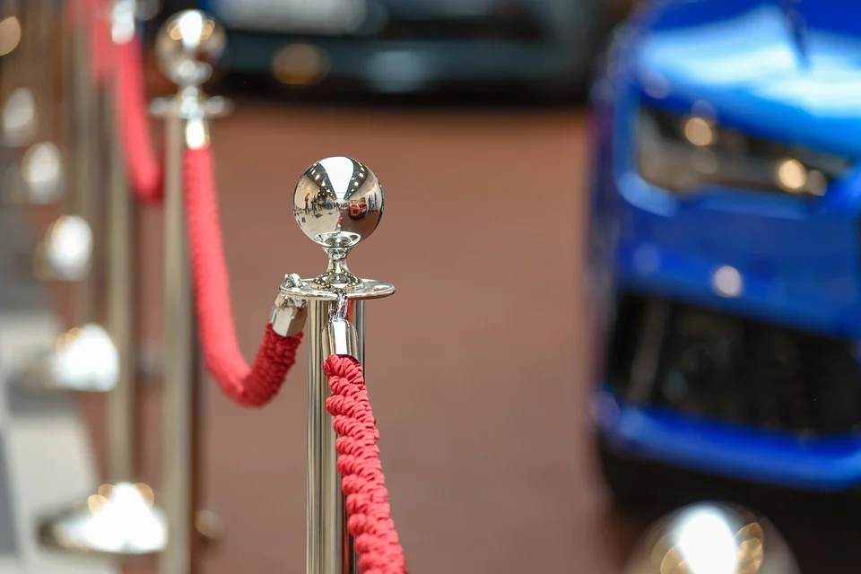
1. Who am I? (vv 18-19) – Do I depend on who I am?
‘Rich young ruler’ with no name given
The big guy surrounded by little people
His identity is not enough
Do you depend on who you are? On your good name? On your status?

Slide 5
3. What About My Stuff? (vv 22) – Do I depend on what I have?
Wealth was seen as God’s special blessing
Wealth negates the need for trust in and dependence on God
It is perfectly possible to own possessions and not be possessed by them
Have we made an idol of our possessions or our finances?
There is a real blessing in receiving help from others

Slide 6
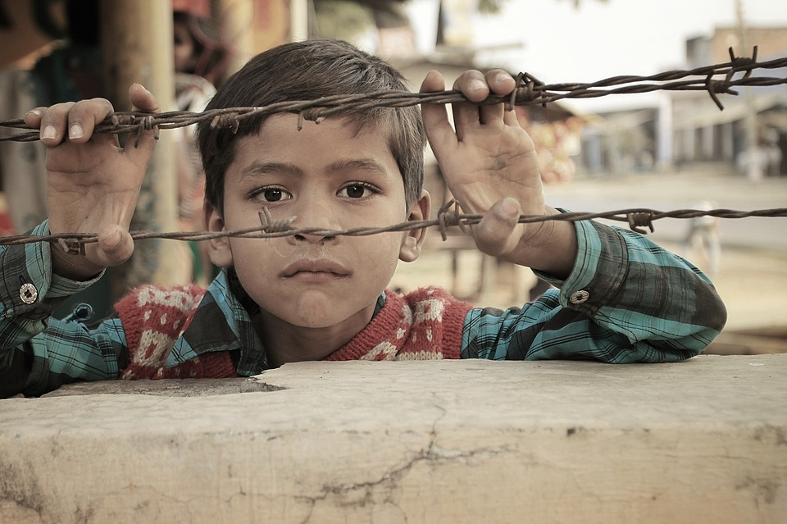
4. Our Dependent Neighbours (v 22) – Why bring the poor into this?
Loving God looks like loving your neighbour
Everyone wins
When God asks something of us, our reactions tell us where our hearts really lie

Slide 7
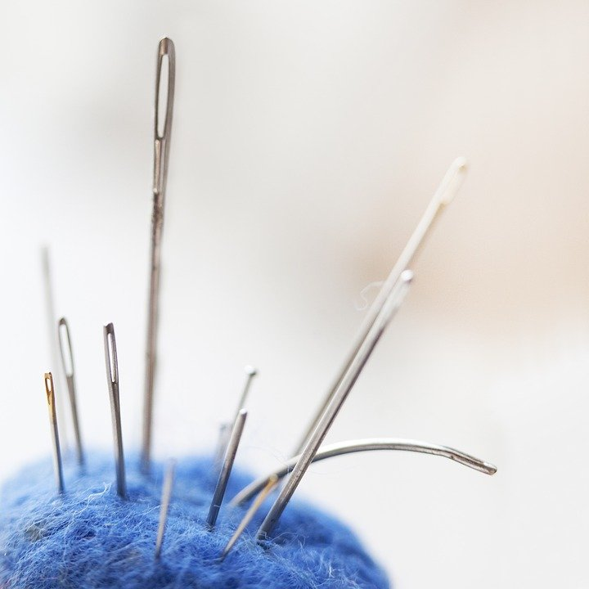
5. Impossible? (vv 23-27) – It depends on the state of our hearts
Is your heart inclined towards God?
Are you willing to depend utterly on him?

Slide 8
6. Are you ready for an Adventure of Dependence? (vv 28-30)
Dependence on God works

Slide 9
What do you depend on?
Do you depend on who you are?
Do you depend on being good enough?
Is there anything that you would not forfeit for God?
Is your heart inclined towards God? Are you willing to depend utterly on him?

