Slide 1
Adapting to get from here to there
Deuteronomy 10 and 11
What matters most

Slide 2
Deuteronomy
Covenant Document
Section 1 Preamble 1:1-5
Section 2 Historical prologue 1:6-4:43
Section 3 General stipulations 4:44-11:32
Section 4 Particular details (12-26)
Section 5 Ratification (27-30)
Section 6 Leadership Succession (31-34)
It’s not about allegiance, it’s about love!

Slide 3
God’s word to the believer
Summarised in 10:12,13
Fear the Lord
Walk in His ways
Love Him
Serve Him whole-heartedly
Observe His words

Slide 4
The heart of God’s word to the believer
A Chiasm where the most important bit is in the middle
Fear the Lord
Walk in His ways
Love Him
Serve Him whole-heartedly
Observe His words
He doesn’t just want your allegiance, He wants your love
That ability to give yourself which starts in a decision and becomes an obsession of joy

Slide 5
Love is at the centre
If you love Him you will keep His commandments (8)
And that will strengthen you for doing His will (8) and taking possession of the Promised Land
It will also put you in the place of blessing (13)
And God will go before you (22)
If you love Him you will be careful to stay near Him (16)

Slide 6
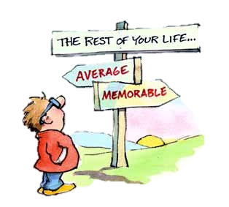
God gives you a choice
Love is a choice, not a bind
There’s no picking and choosing
It’s an offer, not a negotiation
Joshua understood this from these sermons of Moses
His response was ‘You make your choice… but as for me and my house… we will serve the Lord’

