Slide 1
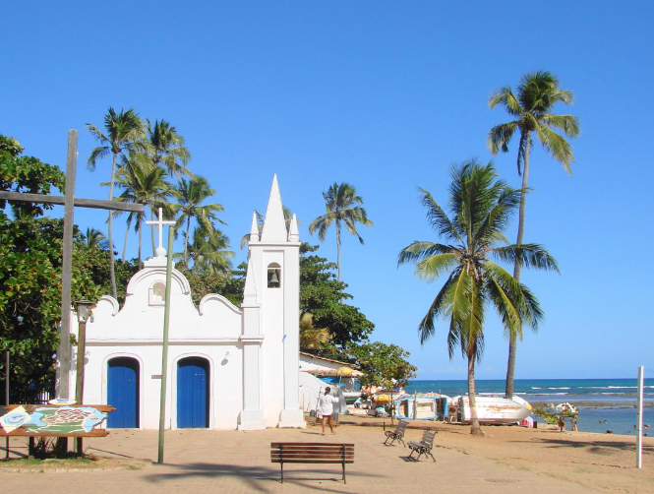
“His Majesty King Dom Manuel,
We do not know if there is gold, silver or any other metal yet unseen. However, this land is very rich in pure air and abundant waters…if you make the most of it, this land will give you everything you desire…”
(Pero Vaz de Caminha)
Bahia, the first State to be discovered in Brazil

Slide 2
‘em se plantando tudo dá’ ‘all that is planted, grows’ (popular Brazilian saying)

Slide 3
The book of James so far…
Trials & temptations (James 1: 1-18)
‘The testing of your faith produces perseverance…’ (v. 3)
Discipline must be done in love.
Listening and doing (James 1: 19 – 27)
‘Everyone should be quick to listen, slow to speak.’ (v. 19)
The importance of holding your tongue and listening first.
Favouritism banned (James 2: 1-13)
‘…believers in our glorious Lord Jesus Christ must not show favouritism.’ (v. 1)
Judging others is something we all do in seconds – why?
Faith and deeds (James 2: 14 – 26)
‘..faith by itself, if it is not accompanied by action, is dead.’ (v. 17)

Slide 4
I know that life is choices Chances all day long Seems my right just always turns out wrong
Some are deeds of ignorance Sometimes disobedience But does it make much difference When it's all rebellion in my heart Can I ever make it right.
I don't do what I know is true I do what I don't wanna do But I do it, oh, yes, I do it
Sandi Patti – The Dilemma, 2009
I suffer from a bad affliction Seems my life's a contradiction Two lives war inside of me And though I want the spirit to win Seems the strong man gets his way I start my life the same each day Praying for a better way Made up in my mind I'm gonna Carry out the good that I desire But it seldom works out right

Slide 5
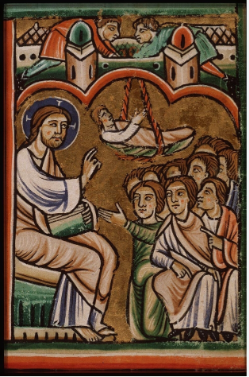
Jesus heals a paralysed man.
Luke 5: 18-25

Slide 6
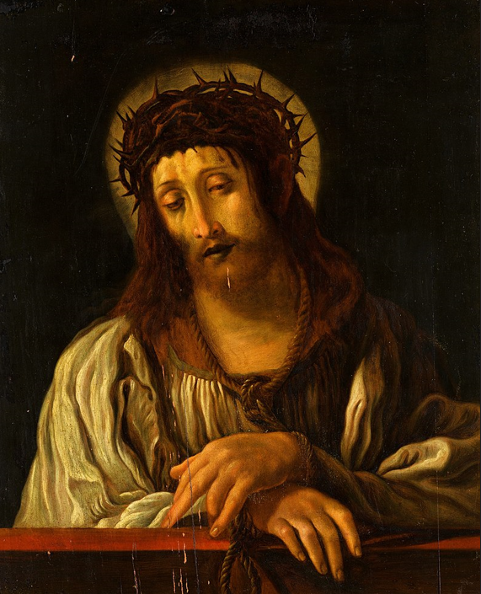
‘I have done all of this for you, what do you do for me?’
(inscription under the painting)

