Slide 1
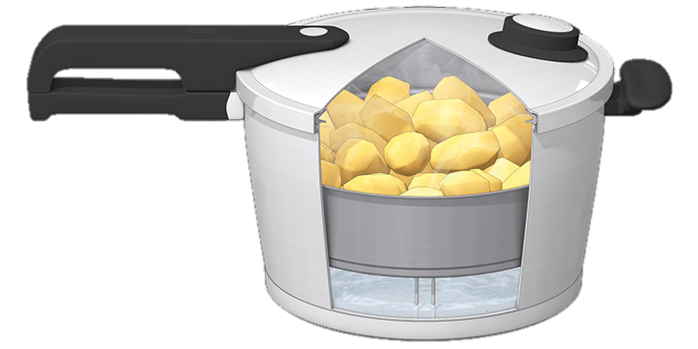
Faith in the Pressure Cooker
The Letter Of James
5 Your religion may not help
1:26-27
Faith

Slide 2
The pressure cooker
The pressure cooker is the place where things get done quickly
It’s where you feel the impact of every decision and you don’t have the luxury of time
It’s where the difference between undercooked, perfect and overcooked is measured in seconds and blowing a gasket can happen often

Slide 3
Sunday after Ascension Day
Jesus appeared, avoided questions, made a promise then left
They had to wait another week or so before Pentecost
Without Jesus or the Holy Spirit
They did religious things

Slide 4
Religion
Has a bad name
From suicide bombings to excusing bad behaviour
People who are religious are portrayed as narrow minded and closed to new evidence
Religious people do things to earn points from a deity
The Pharisees were religious as we understand it
James doesn’t use the word ‘religion’ that way

Slide 5
James 1
Trials will come (2)
God gave us New birth (18) for a reason
God wants to bless us (25)
That blessing is on the road to maturity
James’ signs to look for that we are on the right road (26,27)

Slide 6
God wants your faith to show
But show in the right way

Slide 7
Romans 5:17
Sin
Grace
‘Covers with excess’
Or ‘overflows’

Slide 8
James 1:21
God’s word
Filthiness
‘Shabbiness’
Evil
Character or conduct unbecoming
‘Covers with excess’
Or ‘overflows’

Slide 9
James 1:26-27
Heart of Faith
devotion
‘Religion’
Character or conduct ‘becoming’
‘Covers with excess’
Or ‘overflows’

Slide 10
God wants your faith to show
But show in the right way
‘Religion’ is the overflow from what you believe
Pure religion is shown in 3 ways
Controlling your tongue
Tending the needs of the poor
Personal holiness in an unholy world
These are the ‘tells’ that your faith is real

Slide 11
Pentecost is coming…
What would make Pentecost perfect for you next week?

Slide 12
Faith

Slide 13
This week’s challenge
Turn off the noise and listen
Stop talking and listen
When you hear, follow God’s direction
QUIETLY!

