Slide 1
The risen Jesus 5
John 21:1-14 The miracle within

Slide 2
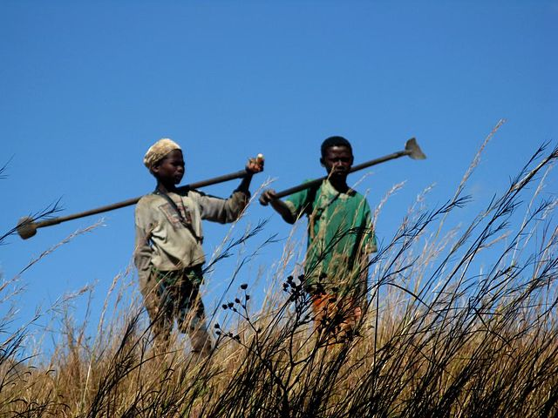
Falling flat
After an adventurous time coming home can be a difficult time
The experience has changed you, but not the people around you

Slide 3
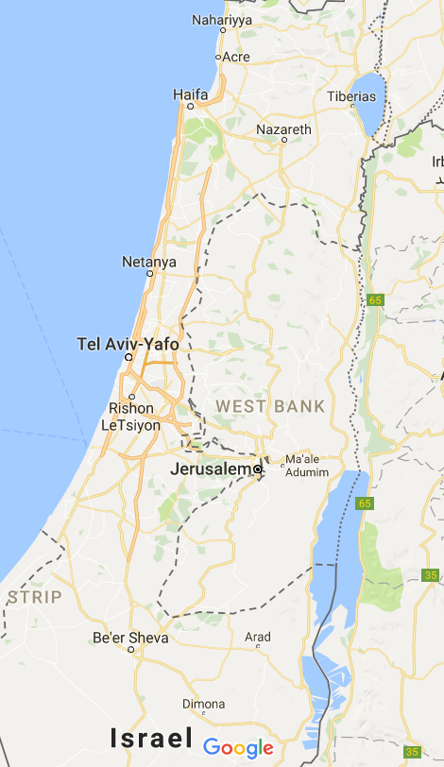
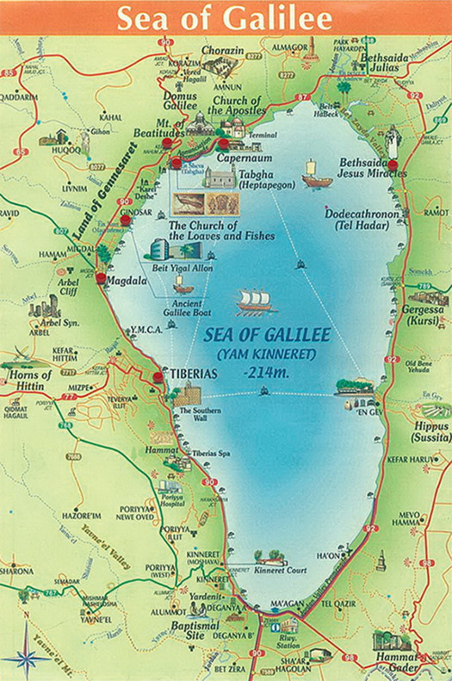

Slide 4
The danger of going back
Thomas went back to acting like a person without faith
This group did the same
These do not look like people who have received the Holy Spirit
It’s a real temptation to wallow

Slide 5
God gives experiences of His presence to encourage your faith
God’s timing is perfect
Jesus arrived and, as before, they didn’t recognise Him
John recognised Jesus by the effect He had
He spoke, they obeyed, things happened
It’s the common story of faith throughout history

Slide 6
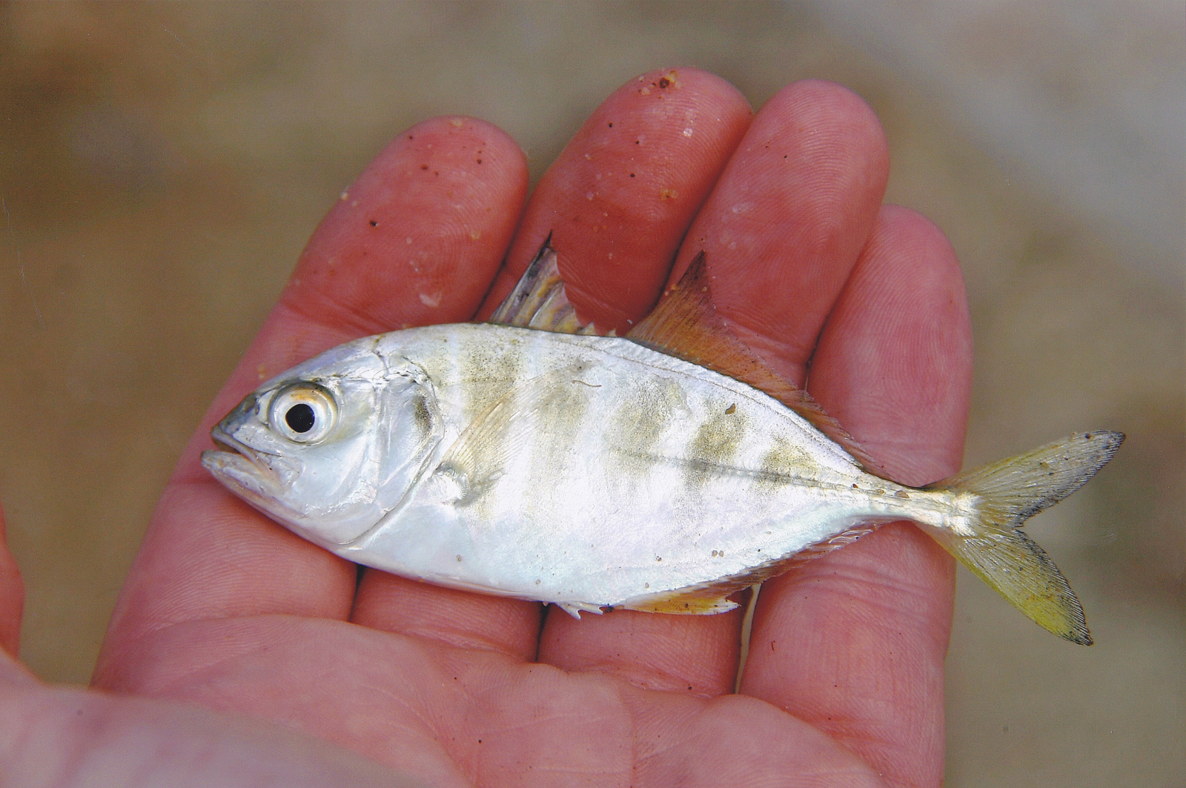
God does not need your fish!
You are not indispensable
But you are invited to bring and share what you have

Slide 7
Jesus is risen
A truth worth believing
A truth worth living for
A truth worth dying for
A truth worth exploring

