Slide 1
The Leading of the Spirit
14. Inspired to break a winning team Acts 13:1-3

Slide 2
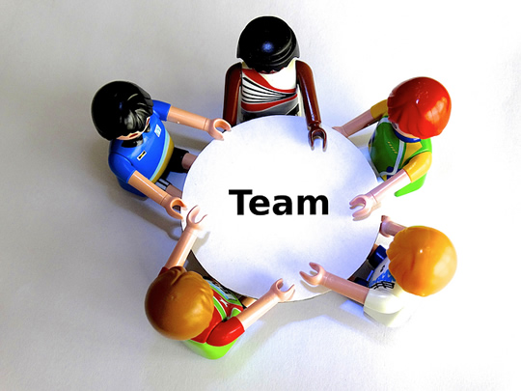
An effective leadership team
They communicate well with each other
They focus on the goals and results
They each contribute their fair share
They offer each other support
They are a diverse group (all unique)
They have a strong leader (Barnabas)
They’re organised
They have fun
You wouldn’t want to mess with that, BUT God does!
It’s not about the team, it’s about the mission

Slide 3
God uses real people
All inspired by the Holy Spirit
Barnabas
Simeon called Niger
Lucius of Cyrene
Manaen
Saul (Paul)
Prophets and teachers in a team
When you’re led by such a team everyone benefits

Slide 4
God speaks
To to change things
Change is costly
He also calls
God tells the church, but He has already called Barnabas and Paul for this mission
Not for the church, but for the kingdom of God in Christ

Slide 5
It’s God’s mission
God’s mission for the world needed a church
The church fasted and prayed and sent them off
In Antioch a new era was born
God’s mission had a church…
Antioch
s
i
s
n
Mission
M
i
o

