Slide 1
How do you love?
1. In the family 1 Corinthians 13 & Ephesians 5:22-6:4

Slide 2
What’s it like in your home?

Slide 4
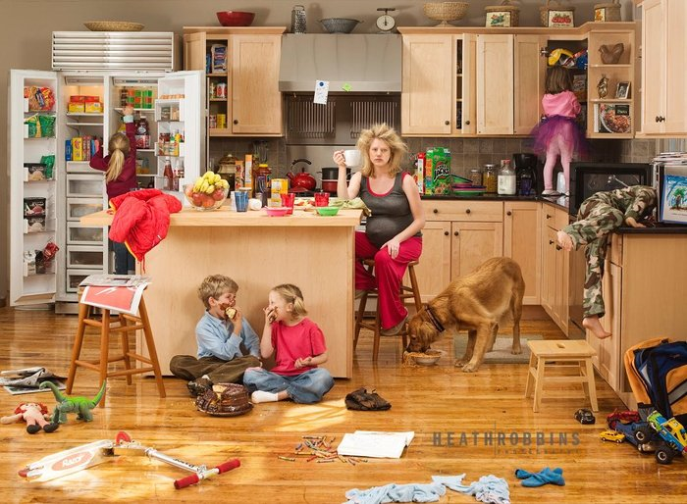

Slide 5
“If it weren’t for my husband we’d be the perfect couple”

Slide 6
1 Corinthians
Heaven on earth in the CHURCH
Written to a church in conflict about the use of their use of spiritual gifts
If you want to be effective in building up the church love is the key
But not any kind of love
Agapé love – the self-sacrificing love, that Paul describes in detail
Use your gifts to build up the Church of God in Christ with this love as your motivational force

Slide 7
Heaven on earth in the home
Is built on the same ‘agapé’ love:
Wives show love by submission and respect
Husbands show love by actions, words and sacrifice
Children show this love by obedience and honour
Parents show this love by allowing them to grow
Don’t exasperate, train and teach
Training is done when the pressure is off, when the outcome doesn’t matter

Slide 8
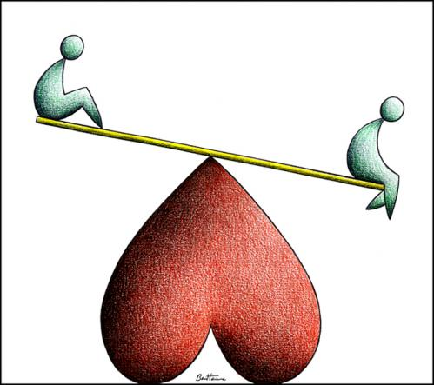
How do you love in the home?
It’s all about the atmosphere
You set that every day you get out of bed, with the first word you say, with the first expression on your face in the morning!
Love is a decision before it is a feeling

