Slide 1
The risen Jesus 2
John 20:10-18 Encountering Jesus

Slide 2
God is not afraid of your questions
The questions to ask
About the passage
What’s it like to encounter the risen Jesus?
How do you know a genuine encounter with God?
How do you know when to stop praying?

Slide 3
What kind of body did Jesus have?
It could be touched and handled (v27, Lk 24:39), and bear the marks of the wounds in death (v 20,25,27), and cook fish (21:9) and eat it (Lk 24:41-43)
BUT it could rise through grave clothes (6-8), appear in a locked room (19,26) and is sometimes not recognised
How can this be?
The seed and the plant (1 Cor 15:35ff)

Slide 4
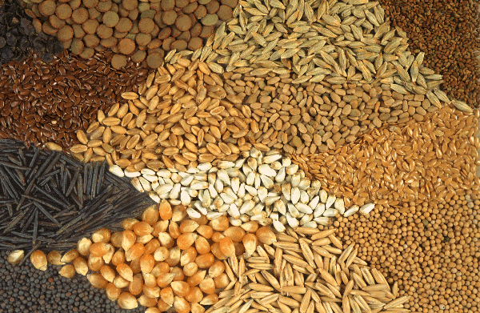

Slide 6
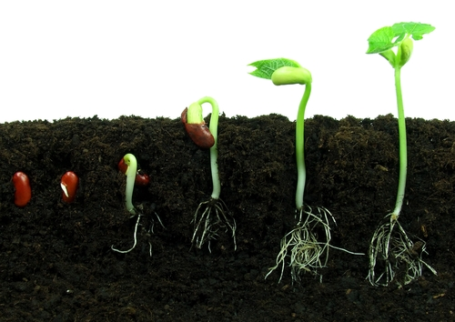
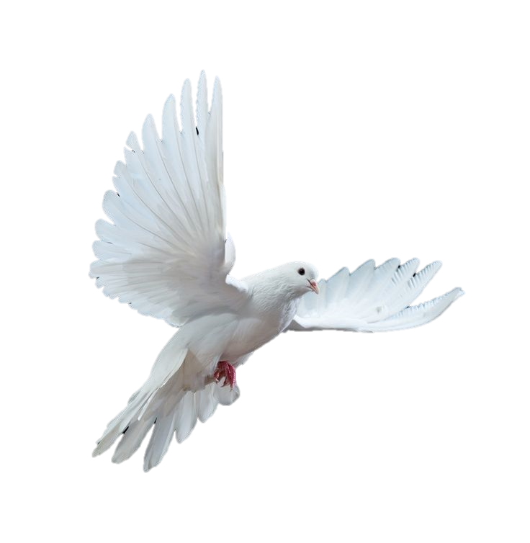
3 days
40 days
7 days
In the tomb
Resurrection
Appearances
Ascension
Pentecost

Slide 7
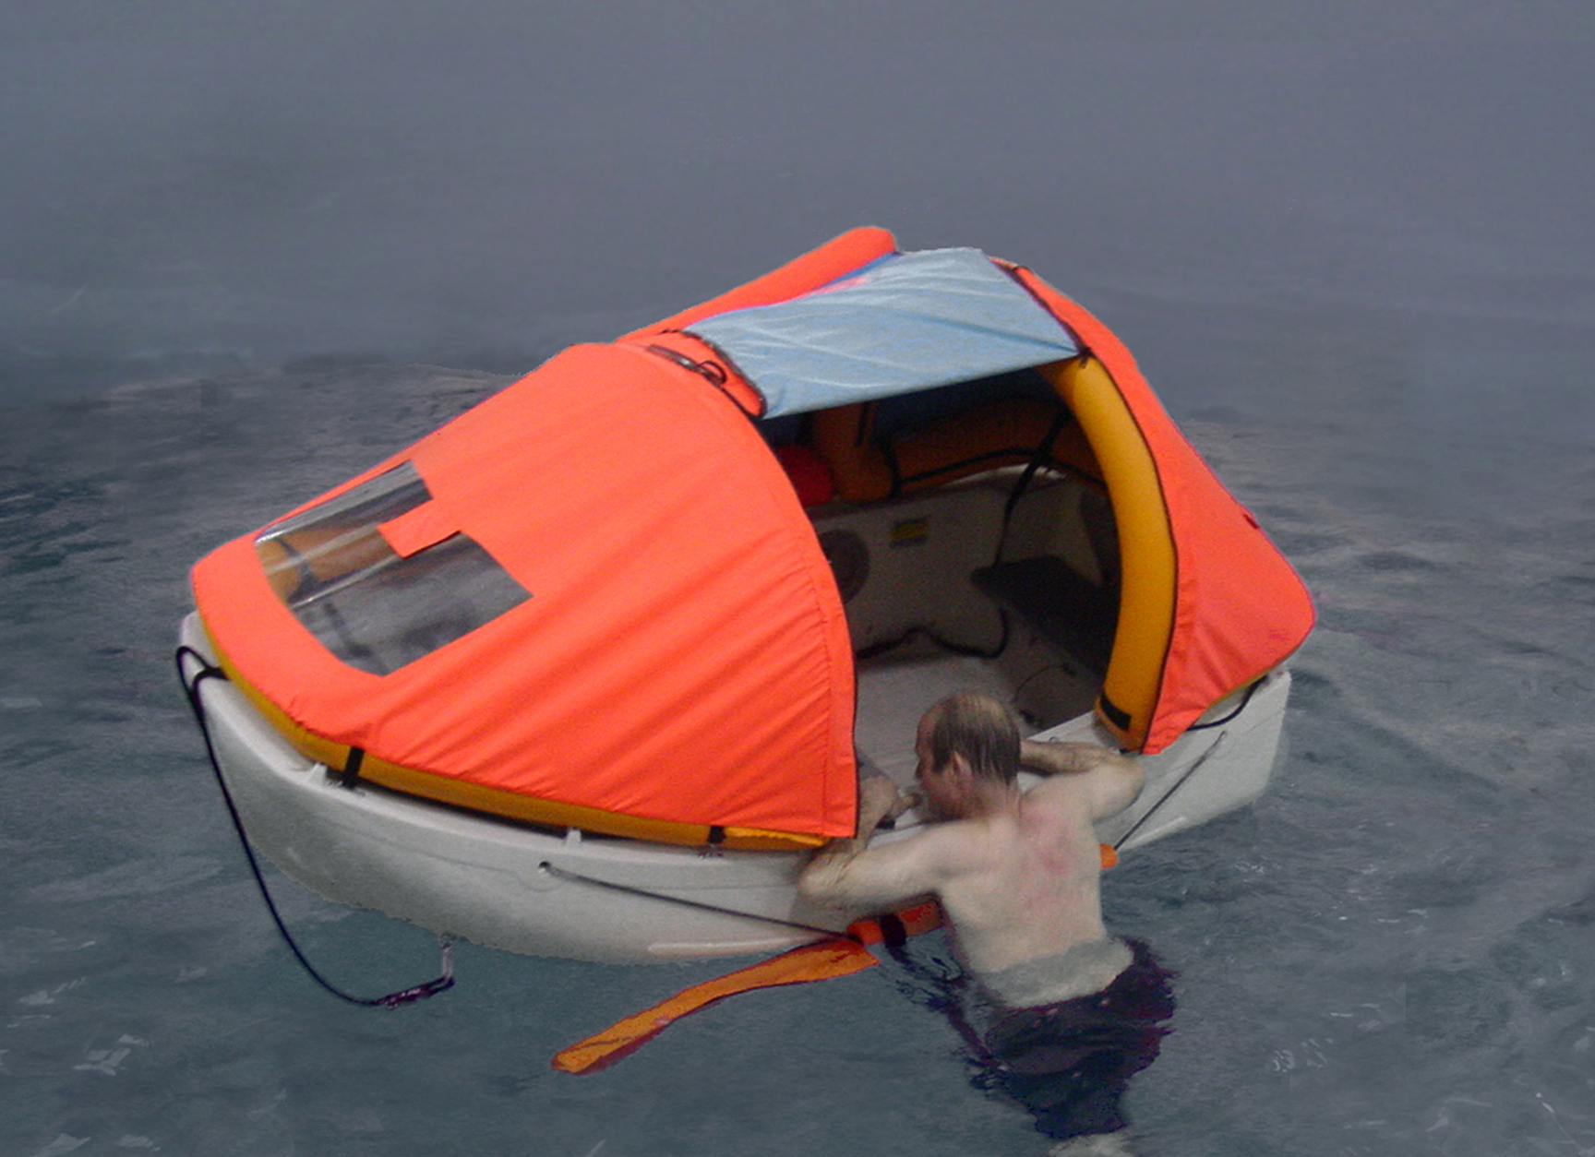
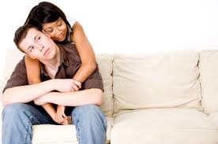
There’s clinging to Jesus and there’s clinging to Jesus…
Cling to me and you will be rescued
‘Don’t cling to me’ – I’m not going anywhere yet
But when I do go I will send another Comforter
‘Don’t cling to me’ – you have a job to do
Take them the Good news!

Slide 8
Jesus is risen
A truth worth believing
A truth worth living for
A truth worth dying for

Slide 9
A truth worth exploring
We celebrate what we know to be true
Jesus Christ rose from the dead and is alive today
But there’s more…

