Slide 1
Samuel
A life well lived in difficult times
4. A life with disappointments 1 Samuel 8 and 15

Slide 2
Disappointments happen
It’s not only because you lack integrity or honesty or character or faithfulness or faith
Samuel remained faithful and served God all his life yet he had big disappointments
The Bible shows:
Bad things happen to good people
God gives opportunities that are wasted
A person of faith can do all the right things and still see failure

Slide 3
Samuel was a man of God
Born under special circumstances
A Nazirite all his life
A servant of God: a prophet and a priest
A judge of Israel
You would think that such a man would have a golden and blessed life
But he was a man with disappointments

Slide 4
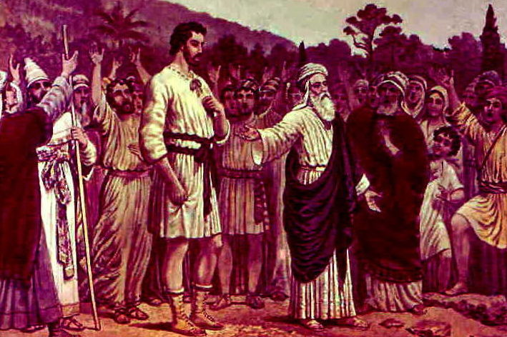
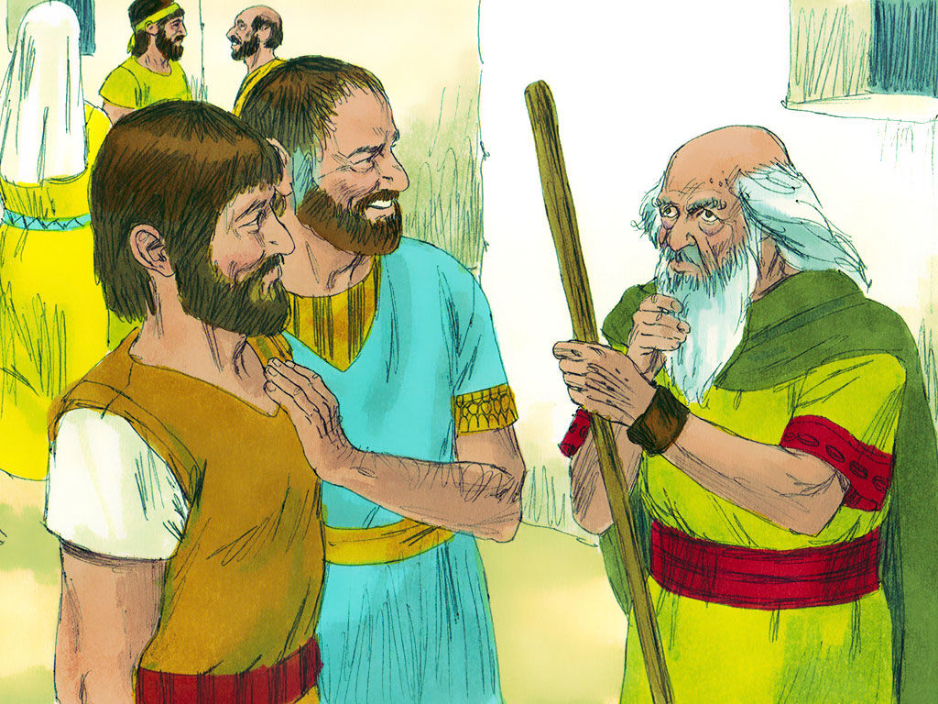
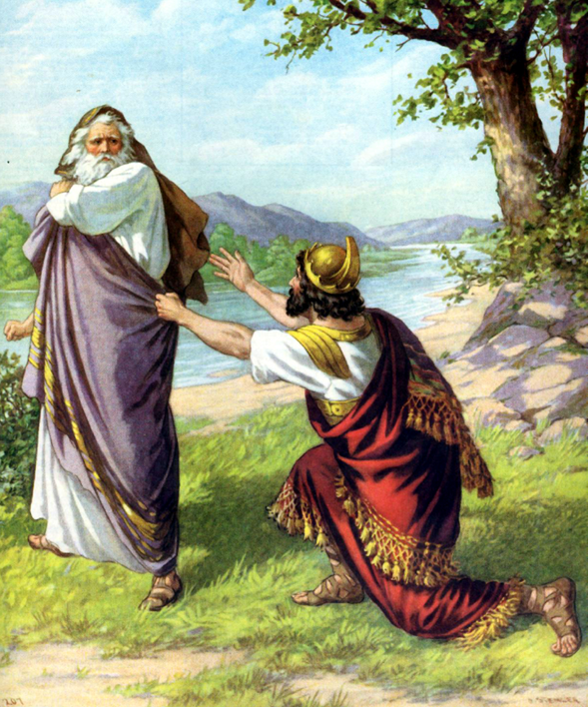
Samuel’s disappointments

Slide 5
God gives opportunities to everyone
How we respond is our responsibility
How others respond is theirs
God cannot be accused of only offering opportunities to good people or successful people
Do not let disappointments ruin your faith
Things will go sour
Your job is to faithfully serve and listen to God

Slide 6
God is a God of grace
He offers freedom and forgiveness to all
All we can do is accept it and live with it – show that it makes us different; especially in the way we face disappointments

