Slide 1
Adapting to get from here to there
Deuteronomy 3:12-29
From HERE

Slide 2
Background
Part of the first sermon/talk 1:6-4:43
Moses is re-telling what has happened so far and pointing to God as he does it
He’s teaching them truths that will help them go into the Land, possess it and stay faithful to God
This is potted recent history
Details of what happened in Number 20-25
The land gained was allotted to Reuben, Gad and Mannaseh

Slide 3
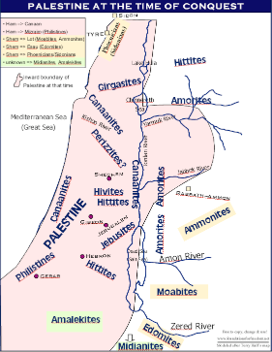

Slide 4
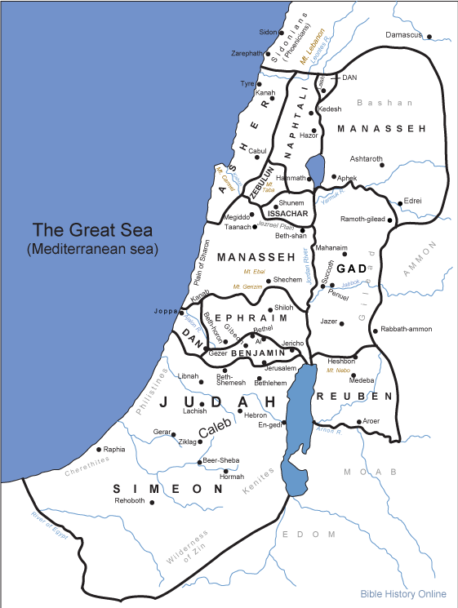

Slide 5
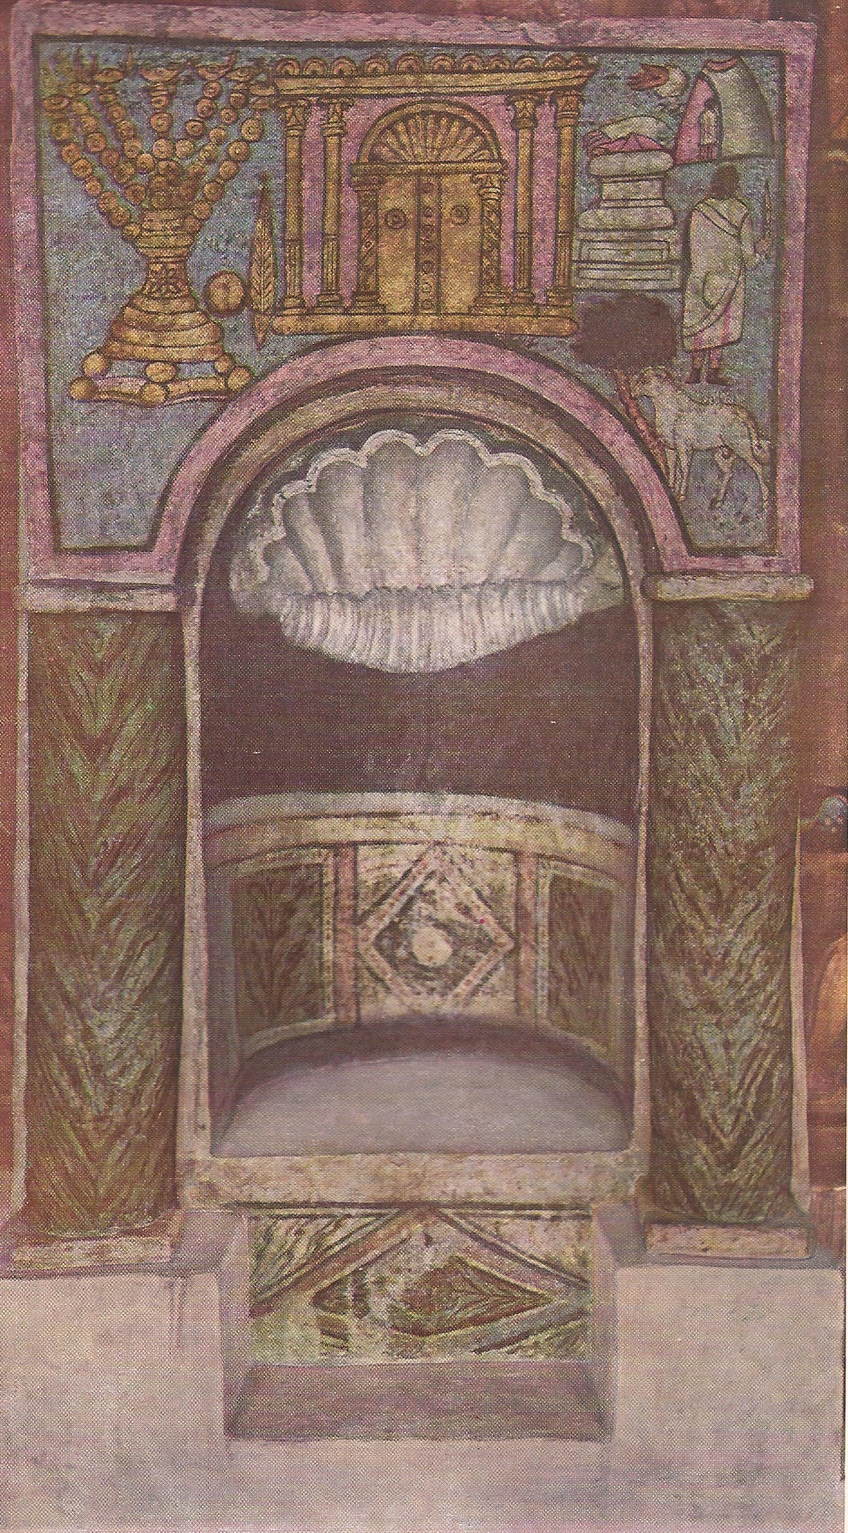
God has a place for you
It’s a niche just for you, but your part is to take possession of it
God will help you, but you must own it
God also has a place for others
But they don’t own it yet
No-one should rest until everyone has their place

Slide 6
God wants you to encourage the next generation
Moses encouraged Joshua by pointing him to the God watching over him
Look what God did to them
God will do the same to others so don’t be afraid: God is fighting for you
God gives us a sense for which battles to fight
When we listen, the battles are focussed and we experience the presence of God

Slide 7
God wants you to know when to stop praying
You can ask God, but when He answers ‘No’ stop asking
God had said ‘No’ and given a reason
Moses was not resentful or bitter about this
He resigns to a God who knows what He’s doing and doesn’t always give explanations
The ‘No’ was to protect the people and give them a lesson on obedience that would be difficult to forget
Being God’s servant and obedience to detail are necessary companions

Slide 8
Remembering difficulties
The valley near Beth Peor was a reminder of their failure (Num 25)
They ate sacrifices offered to Baal and dabbled with the women of Moab who used sex in worship of their god (Num 25)
Many died there as a consequence of their disobedience
Moses is reminding them of their calling towards the one true God who gave His Law to protect His people from harming themselves and enhance their walk with God

