Slide 1
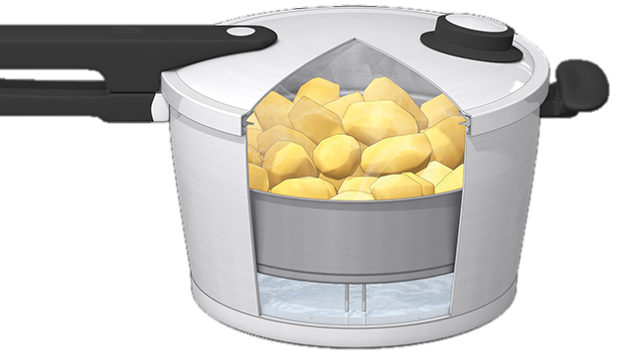
Faith in the Pressure Cooker
The Letter Of James
10 Wisdom matters
3:13-4:12
Faith

Slide 2
What have the following got in common?
Ice cream and frozen foods
Camel Urine
A herbal drink from Madagascar
Cow urine
A mixture of chloroquine and hydroxychloroquine
Lemons Bananas Mangos Onions
Cotton Balls soaked in Violet oil
A Greek hand cream
Colloidal silver solution
A herbal drink from Sri Lanka
Sap from Makabuhay plants
The source of your wisdom matters
Your wisdom dictates your behaviour, your attitudes and your values

Slide 3
Wisdom
Is a wonderful thing
Mentioned 222 times in the OT
We are urged to get it
Wisdom is the application of knowledge
Wisdom is about people
Some people don’t have a lot
Talmud: a wise person is one who can see the future

Slide 4
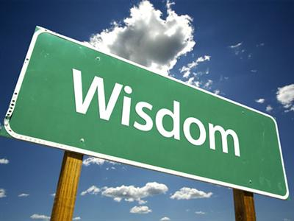
James: the two sources of wisdom
Heaven
Elsewhere
Two sources from which you can predict the future
One turns you into a lovely human being
Your source of wisdom matters!

Slide 5
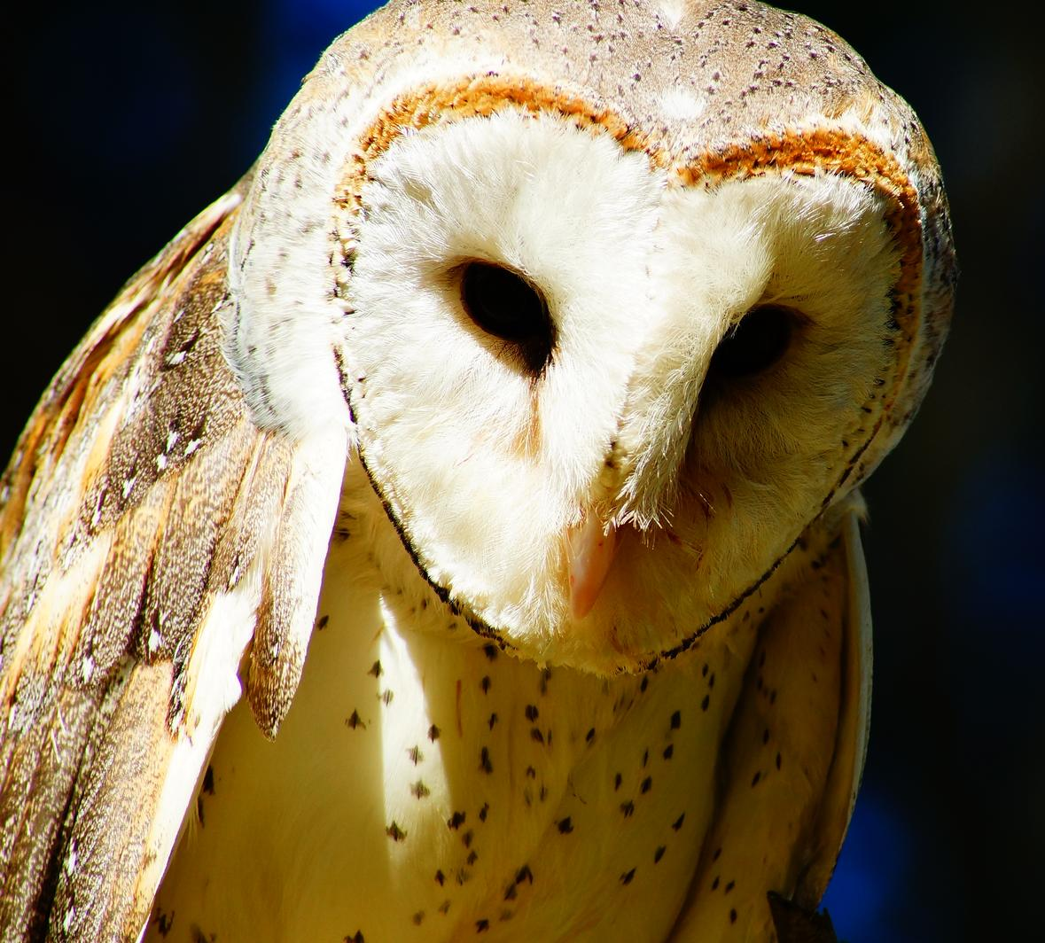
God’s wisdom is different
First: it’s pure!
It is not contaminated
Then it follows lines of justice, mercy and grace
It’s peaceable
It’s forbearing
It’s compliant
It’s merciful
It produces good fruits
It is without uncertainty
It is without hypocrisy

Slide 6
God’s wisdom is available to you
James says you have to ask for it
It’s free, but there is a price to pay:
Submit
Flee
Wash
Purify
Yearn
Humble yourself
Use your mouth for good

Slide 7
Challenge
Listen to your own words this week
Where did you get that from?
Ask ‘what is the wise thing to do here’?

