Slide 1
The Leading of the Spirit
2. Inspiration to bring healing
Acts 3:1-10

Slide 2
Credit where it’s due
Many of us want appreciation from others
But God asks for a different attitude from believers
One that can sustain us through times of being taken for granted and restore the soul when being moaned about

Slide 3
The leading of the Spirit in Acts
Luke wrote Acts as the second half of the Good News (1:1-4)
In the first book (Luke) he tells of what Jesus began to do and to teach until the Ascension (1:2)
In this book he goes on to tell what Jesus continued to do through the Apostles and Church when they were baptised in the Spirit
Luke wrote Chapters 3 & 4 to follow chapter 2
It’s a repeat of the structure but the result is different
Acts is telling us ‘there is no formula in a relationship with God’

Slide 4
The Holy Spirit moves
A demonstration of 2:43
The story is told in a matter of fact manner
He surprises everyone
Peter is inspired to speak out of what he has seen and heard
He saw Jesus do miracles and knew that it was possible
He saw that Jesus didn’t have to work himself up to do a miracle
Luke 5:17b ‘the power of the Lord was present to heal the sick’
It was about the Spirit’s presence and blessing in a particular way

Slide 5
The response of faith
Peter’s words & actions
‘Look at us’
‘In the name of Jesus Christ of Nazareth, walk’
This statement is about the continuing power of Jesus
A helping hand
The man’s reaction
Walking and leaping and praising God
This is a fulfilment of a Messianic prophecy in Isa 35:6
He went into the temple with them
This left people amazed…
They recognised the man and that God had been at work

Slide 6
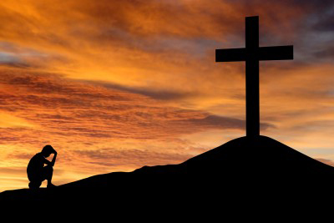
The focus of God's glory is Jesus
God works through the humble
If you are following Christ closely you may not get the credit

Slide 7
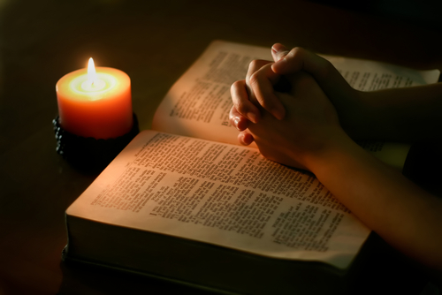
If you would like God to use you to bring healing
Recognise the moment
Seize the moment
Do it for them
Do it for God’s credit

Slide 8
Being
is scary!

