Slide 1
Succession Planning
Sharing the Covenant

Slide 2
4. Bless the team
Deuteronomy 33
This Photo by Unknown Author is licensed under CC BY

Slide 3
Celebrating in context
In the last chapter Moses was warning everyone to not go off the rails, to stay faithful, obedient, listening and serving
In this chapter Moses blesses God’s people
Before he does that he gives a few verses over to God to remind them what He is like
It’s the context of his blessing
It’s the reason for his blessing

Slide 4
we know the God of blessing (1-5)
We have Yahweh, the God who loves us
A central theme of Deuteronomy
The God who teaches us
To be obedient
To be righteous
To be holy
To serve
His rightful place is ‘King of the upright (Jeshurun)’
God comes to Jeshurun
God protects Jeshurun
God instructs Jeshurun
God leads Jeshurun

Slide 5
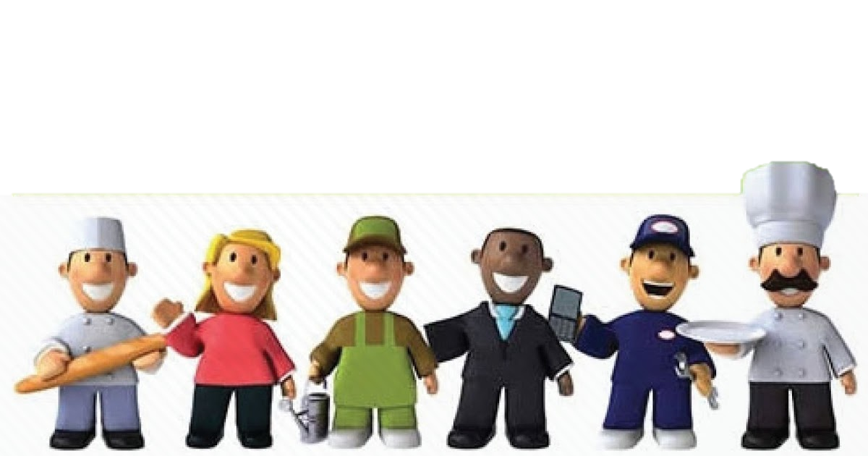
God blesses individually (6-25)
Each tribe named
Each blessing different
No Simeon in the list
The blessing of Levi
Most relevant to us who are called to be a royal priesthood and holy nation through Christ
May your Urim & Thummim work well
They are sold out for God

Slide 7
God is for us (26-29)
He comes to us
He is our refuge
He opens doors
He provides safety and security
He saves us
He shields us
He helps us
He raises us up
We can all be Jeshurun because of the cross

