Slide 1
The Leading of the Spirit
4. Inspiration to defend the good news Acts 4:1-12

Slide 2
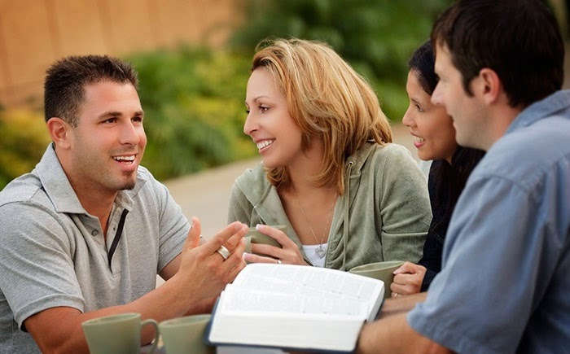
When do you defend your beliefs?
To know which battles to fight and how to face them needs:
The inspiration of the Spirit
The wisdom of Solomon

Slide 3
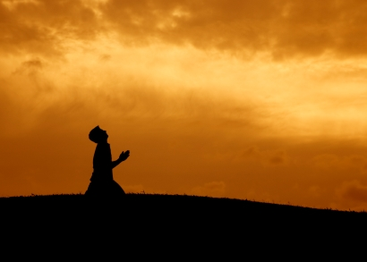
How does God work in the world and who does God choose to use?
The Pharisees
Believed in Moses and the prophets and God intervening in history
Believed that there was a heaven and that people could aspire to it
Were awaiting a Messiah who would put things right with God and in the world
The Sadducees
Believed God only spoke through Moses
Believed when you die, you die: there is no resurrection
Believed the Messianic times had started in the 2nd Century BC under the Maccabean revolt
It was inevitable that a clash would come
According to both: Peter and John were deluded and heretics

Slide 4
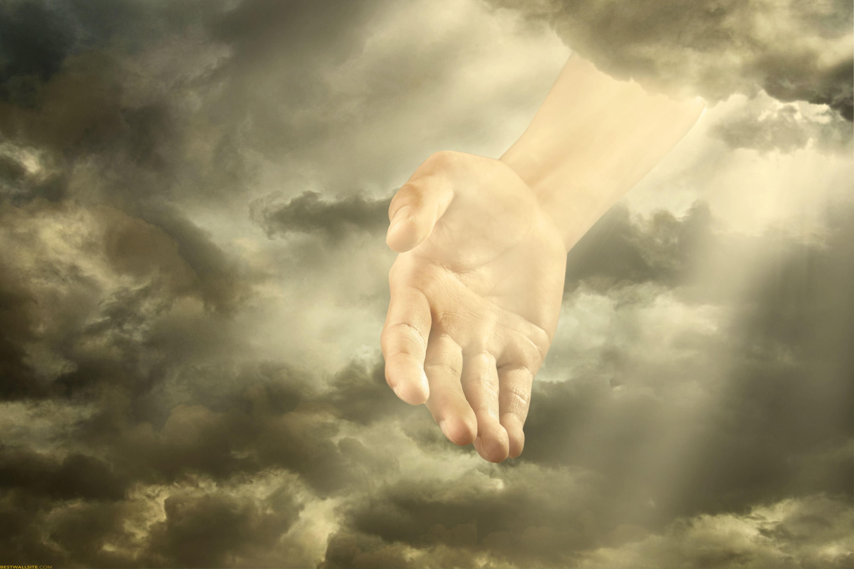
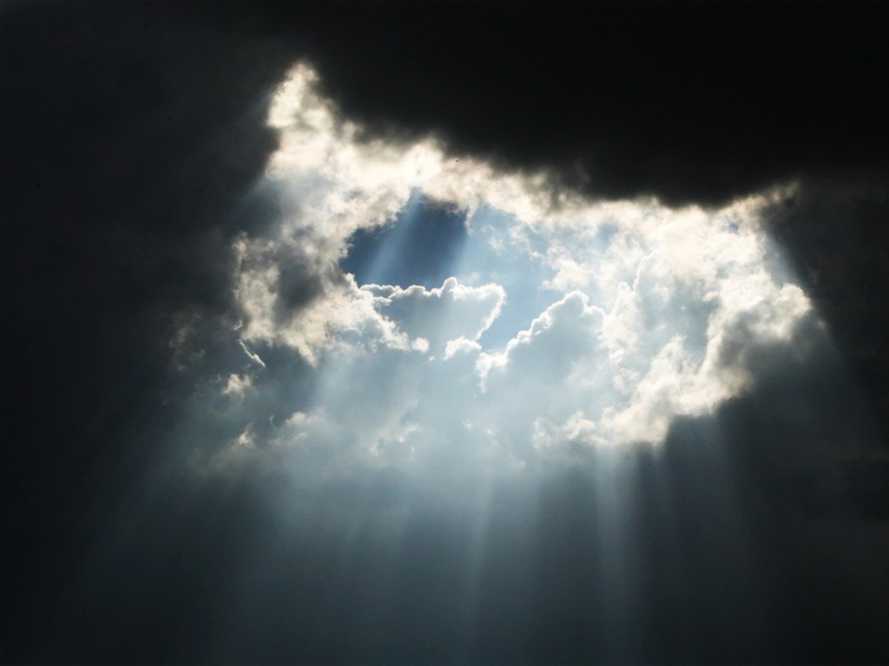
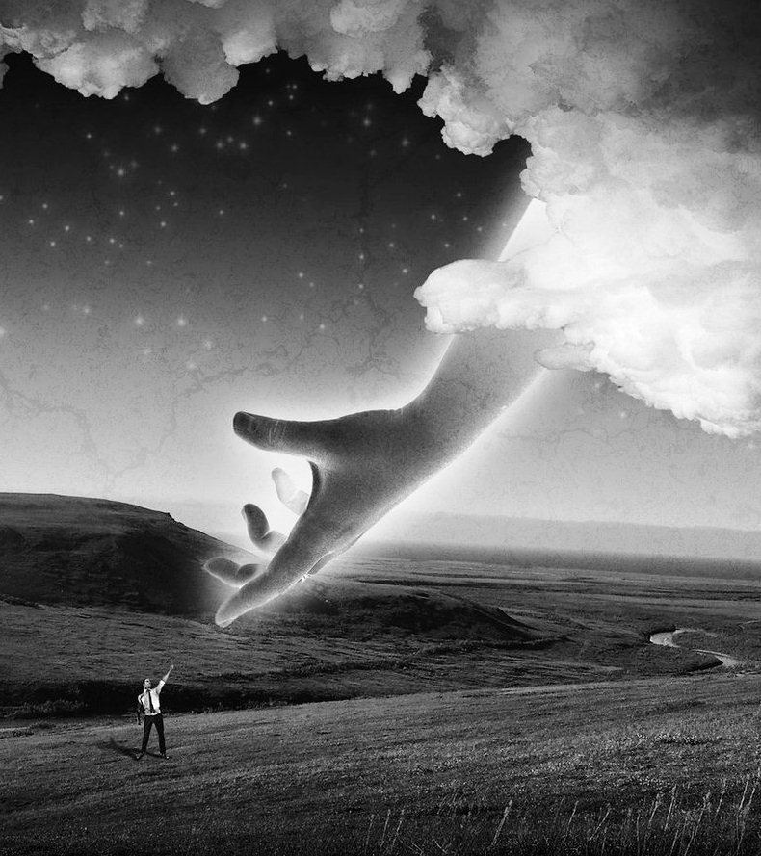
God gives the power
He works through humble people
Those who want nothing more than to be a vessel of His purposes
Those who reject the glory and satisfaction for being right

Slide 5
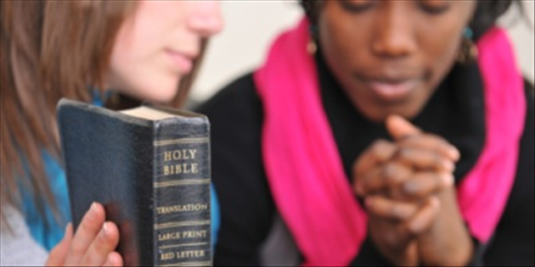
God offers a rescue through Christ
God will clean you up
You’ll be given the chance to get things right as a servant of God
You’ll be given the opportunity to serve others in the name of Christ
You’ll begin to see your life transformed as you seek to honour Christ in all things
Test of progress: people will praise God because of you
Then you will be questioned…

Slide 6
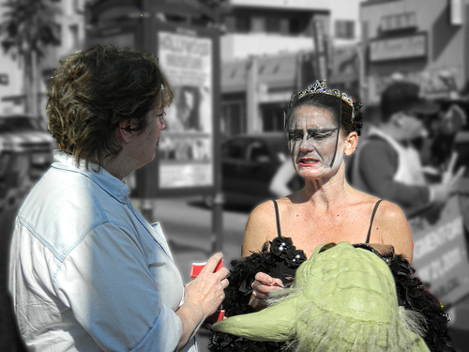
We do this by the power of Jesus
Peter moves from healing to salvation
No-one else
No other name
“We’re not theologically trained, BUT stuff still happens through Jesus!”

Slide 7
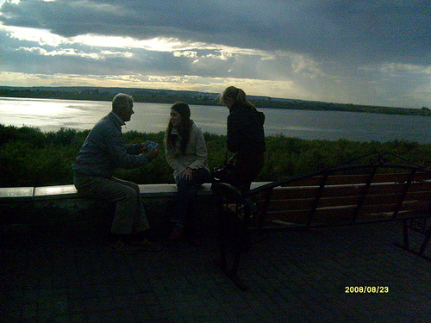
God wants to use you as an example
You’ll be asked why
Rely on Him to lead you but make sure you don’t bottle out
‘I do this because of Jesus… let me tell you what He’s done for me…”

