Slide 1
Samuel
A life well lived in difficult times
2. At boarding school 1 Samuel 3

Slide 2
God has called you
God's call often comes in the guise of a familiar voice in our heads
Part of God's nature to call people to faith
Next time He calls make sure you respond with faith
Speak Lord, your servant is listening…

Slide 3
The call of God is resistible
Samuel in the Bible because he didn't resist the call
He became a great leader because he heard and acted accordingly not just once but on a regular basis
He was the key person in the second major cultural change the Israelites faced

Slide 4
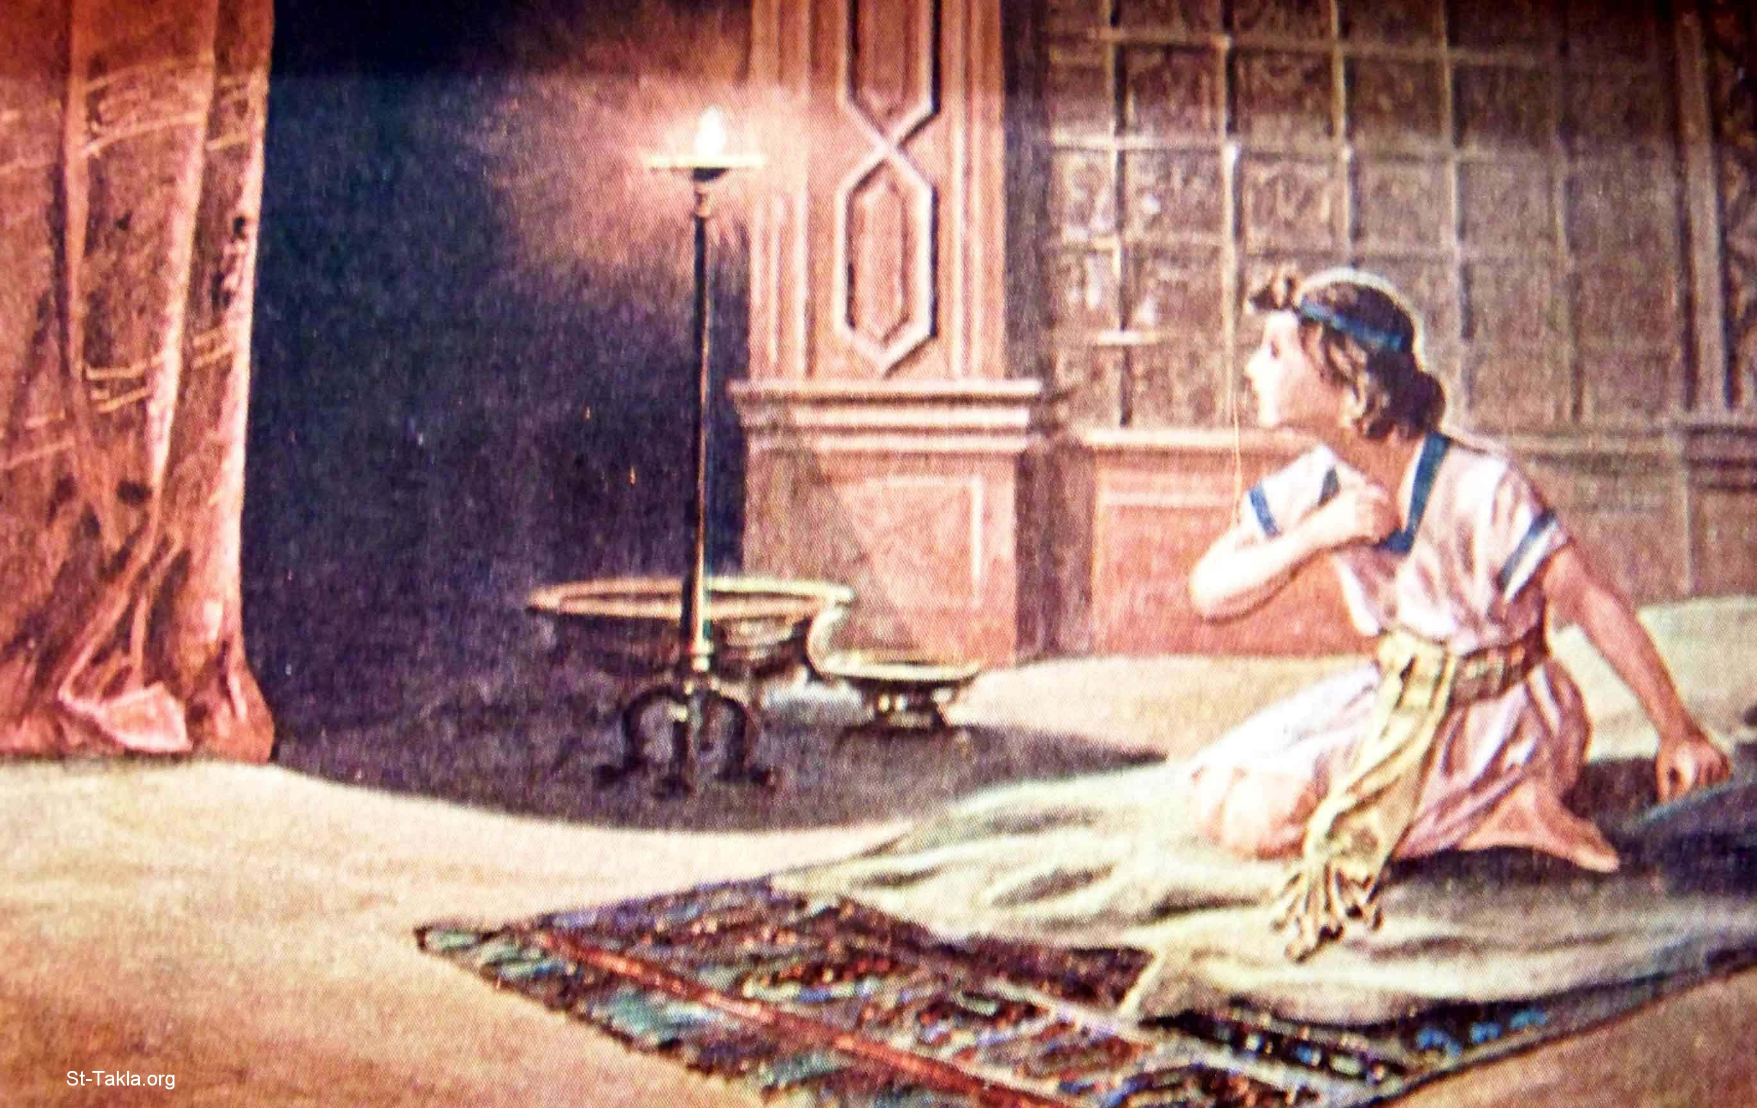
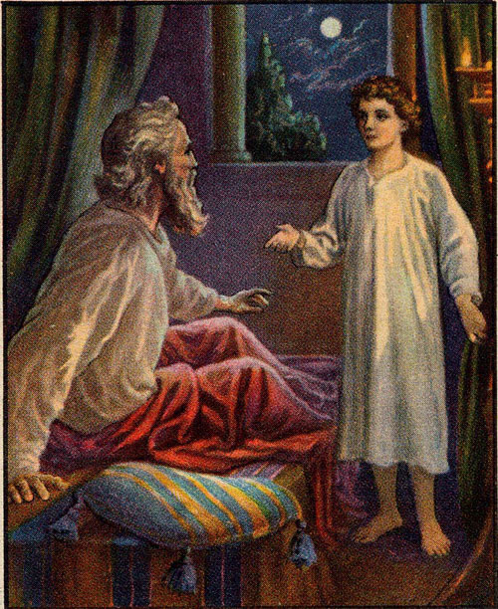

Slide 5
God speaks: Learn to listen to God
Samuel’s story to help you learn to listen to God
It took an older, wiser person to pass on the way God communicates
Not through the Law alone, but by His Spirit at work
Samuel’s first encounter with God was to give him information
God keeps His word
God does not ignore the sins of His servants
Samuel did NOT know how his part would fit in
Samuel was used greatly but he was NOT perfect

