Slide 1
Adapting to get from here to there
Deuteronomy 1:19-46
Afraid of the future?

Slide 2
Can be a great spur or a great burden
When afraid of the future you can make errors of judgement
Future

Slide 3
Holding it together
They agreed to become a nation of priests (Ex 19:6)
Moses expounded the Law (1:5)
The 10 commandments
They set out from Mount Horeb
11 days later (1:2) they arrive about 100 miles north at Kadesh Barnea
It’s a tough journey (1:19)
Sometimes we go through tough times, but they’re not forever

Slide 4
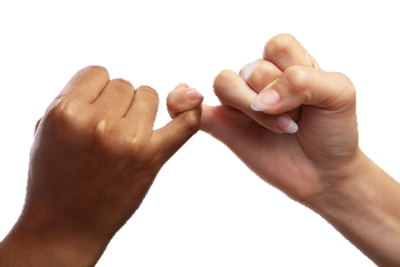
God keeps His promises
His Promises are real
The Land is there but you’ve got to take it
The rebellion reflected their hearts toward God

Slide 5
God offers the golden moment
Moses was given a second opportunity (Ex 3)
The rescued people of God were NOT given a second opportunity
It went to their children instead

Slide 6
God knows every heart
He distinguished between Joshua & Caleb and the others
They entered the land because God was gracious

Slide 7
God’s offer: It’s your choice!
Life as a priest of God is a wonderful life!
You know where you fit in and where you belong
You know the joy of forgiveness
You know where you’re going and have peace with God
You don’t just pray and read your Bible you engage with the creator and sustainer of the Universe and the resurrected Jesus
If God is knocking today…
You will miss out if you don’t take it!

