Slide 1
Applying the Covenant
6. Deuteronomy 20:1-20 Soldiering with a difference

Slide 2
Boundaries
To what extent should your religious life impinge on your secular life?
Should it affect your work life at all?
Should it affect your home life?
Should it affect the way you interact with people?
Should it affect you deal with your enemies?

Slide 3
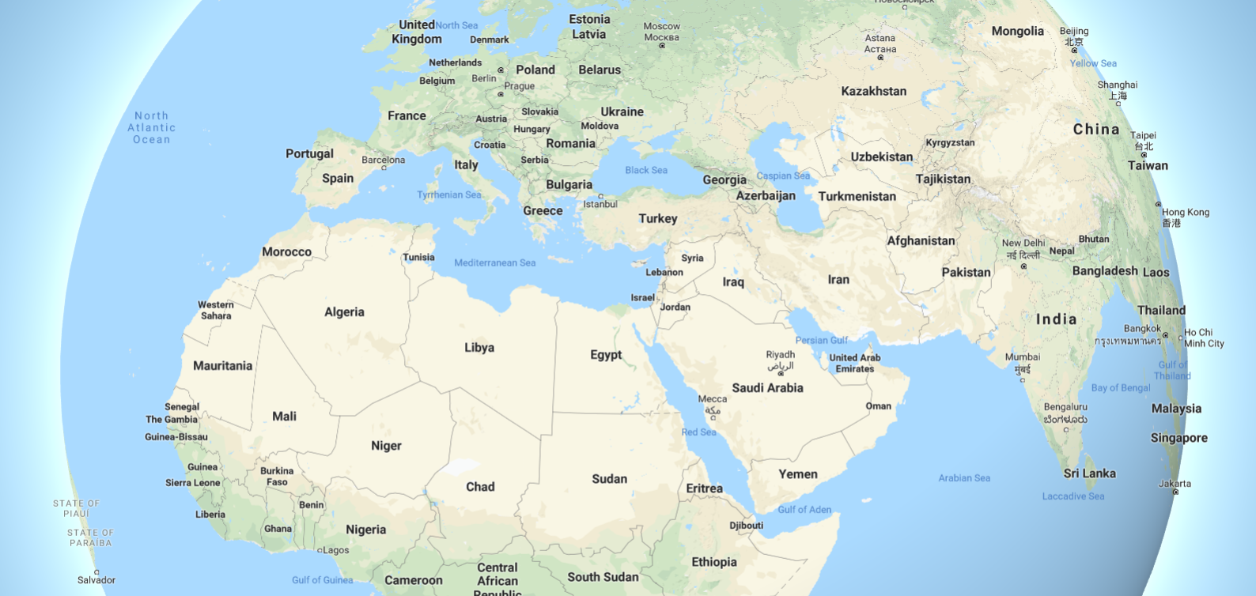
God’s people will be a minority
Deuteronomy recognises that God’s army will always be a minority
Look where He chooses as the Promised Land
If they do engage in battle they are to do it confidently, wholeheartedly and compassionately
God’s people don’t stop being representatives of God
That may make them tentative and afraid
Consult God first

Slide 4
God wants you to engage the world with confidence
For that you need to pick the right battles
The battles which happen because you’re doing the right thing for the right reasons
If you do that there’s no need to fear because it’s not your battle but God’s
God is with you in the right battle
You know that from your history
You know that from the promises God has made to you

Slide 5
God wants you to team up with the right people
Weed out those whose minds are elsewhere
Weed out those who don’t want to fight the injustice
God will call some of us to His causes
The battle is God’s and He knows your needs and your pressures
He is a blessing God, not a demanding one
You are not being invited to do all of God’s work on your own
Your battle may not be my battle
But we are on the same team

Slide 6
God wants you to be magnanimous in victory
For those far away
Offer peace first
For those who want to destroy your way of life and undermine you who are and are close at hand
Have no mercy on destroyers
Have mercy on the environment
Here we have God limiting their activity

Slide 7
