Slide 1
Adapting to get from here to there
Deuteronomy 4:1-43
See the invisible God

Slide 2
The story so far…
Moses has reminded them of their journey
4:1-43 a mini covenant document
Shows the heart of God for people
Shows the mind of God on those who wander off the path

Slide 3
God’s gifts are yours to enjoy
The Promised Land is not yours to keep but yours to enjoy
If you don’t live well in it you will be treated the same as the previous occupants
The Law is to enable you to live with joy, peace and safety, with God in your midst
Keeping the Law will show others you have been with the living God and that you know who you are and where you belong
You don’t need idols
You don’t need Moses

Slide 4
God chose you
A people with no hope
A people who can pass on a legacy to their children and grand-children

Slide 5
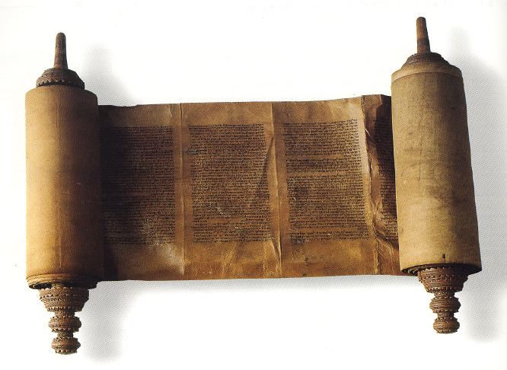
God’s Law is for your good
The benefits of obedience are 3-fold (1)
That you may live
The Law was given so that you could know real life
That you may go into the Land
The Law was given to help you win the battles that need to be fought
That you may take possession of the Land
The Law was given so you could make your niche your own without damaging yourself or others
Life will go well generally but…
This Photo by Unknown Author is licensed under CC BY-SA

Slide 6
The heart of God is for you
Even if you stray from the Law God will not abandon you but He will remove you from the place of blessing
When you come to your senses and seek Him with all your heart and obey His Law then He will be merciful and bring you back
You will find that place called ‘home’

