Slide 1
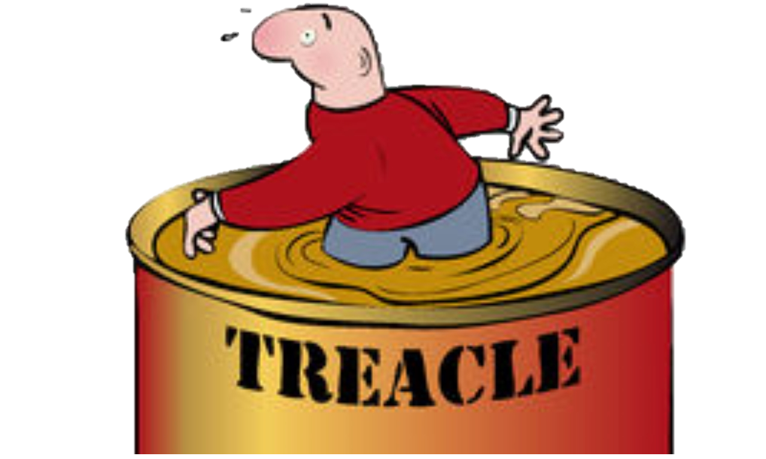
Walking through treacle
4. Big picture actions
2 Corinthians 2:3-17

Slide 2
Pain
The people who should make you rejoice don’t!
Do we confront them them?
Do we pick our battles carefully and give up on the rest?
Do we back off to fight another day?
Do we back off and leave them to it?
In 2 Corinthians Paul is giving us a model of how to handle difficult situations and tells us it’s not about us, it’s about the bigger picture so be people with humility and integrity in dealing with pain

Slide 3
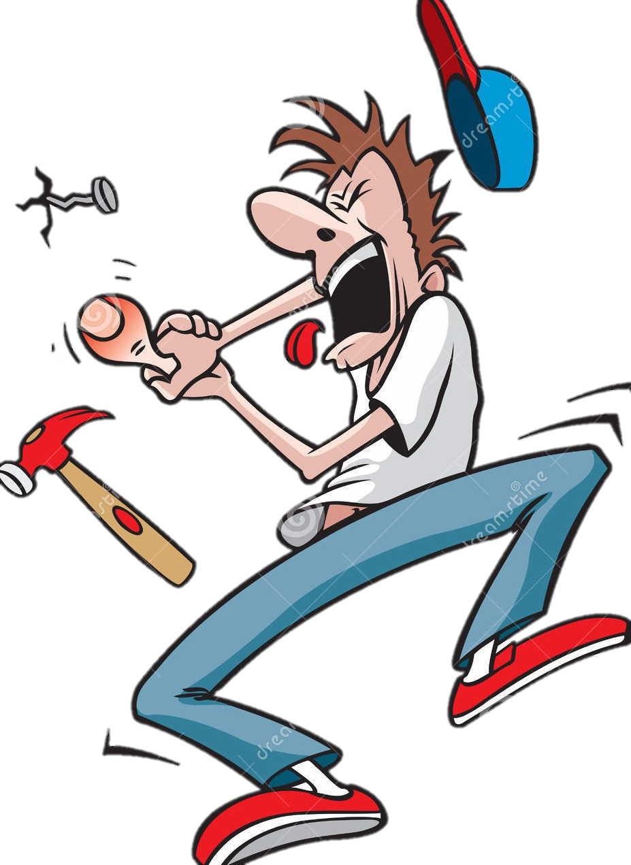
God wants you to show your priorities
Not all pain is bad
Walk towards the pain
The greater the reward the greater the pain people are willing to face
Forgive and restore
It is difficult to do without a bigger payoff in mind

Slide 4
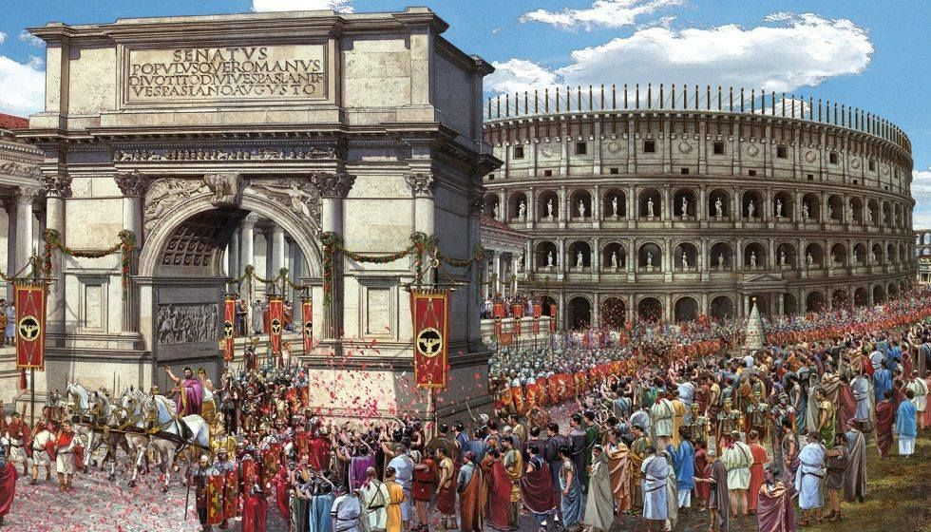
God has a picture for you
Draw on the bigger picture
Where do you want it to end?
For Paul it’s Christ is leading us as captives in a triumphal procession across the earth using us to spread the aroma of the knowledge of God

Slide 5
God wants to lead you
Let the peace of God rule those leadings
It settles your heart and doesn’t give up on others
If you have the peace of God
You sense the love God has for you and the other person;
You sense the longing He has for their restoration
You bow in worship because you know it’s good for them and for you

