Slide 1
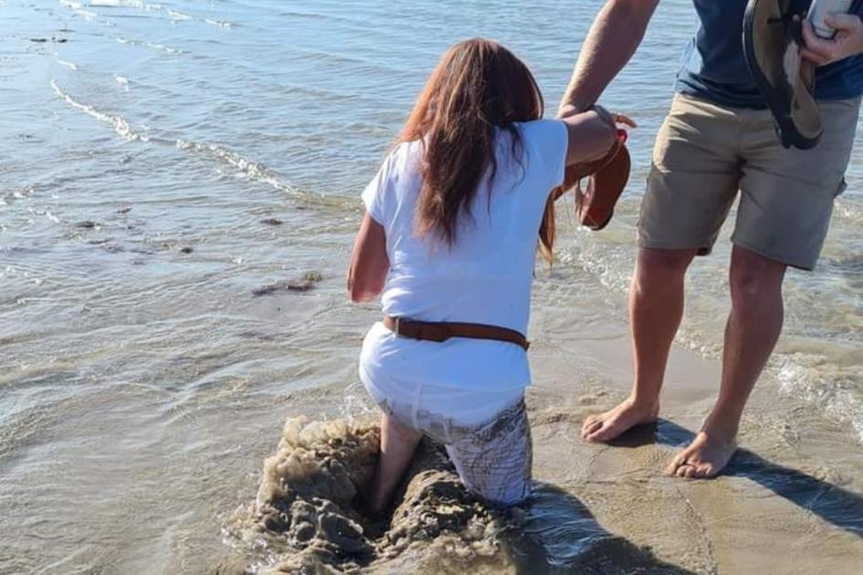
Psalm 40
Deliver me!
Rescue me!

Slide 2
I waited patiently for the Lord; he turned to me and heard my cry.
He lifted me out of the slimy pit, out of the mud and mire; he set my feet on a rock and gave me a firm place to stand.
He put a new song in my mouth,
a hymn of praise to our God.
Many will see and fear the Lord
and put their trust in him.

Slide 3
Onto
Into
Out of

Slide 4
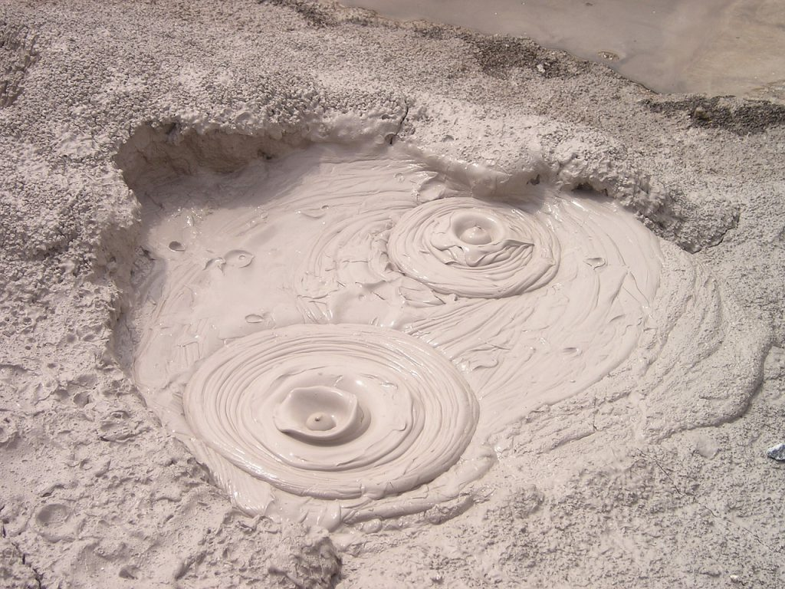
Out of

Slide 5
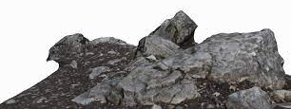
Onto

Slide 6
Into

Slide 7
Knitting
with two
colours

Slide 8
Thanksgiving
Prayer

Slide 9
But as for me, I am poor and needy; May the Lord think of me. You are my help and my deliverer; You are my God, do not delay.

