Slide 1
The Focused Jesus
Jesus’ ministry in the last week of His mortal life
John 12:1-19:42

Slide 2
John
1:1-18 Tells us what John believed about Jesus
The rest gives us the evidence of why John believed it
12:1-19:42 covers the last few days of Jesus’ natural life
These chapters contain Jesus’ most pressing actions and teachings

Slide 3
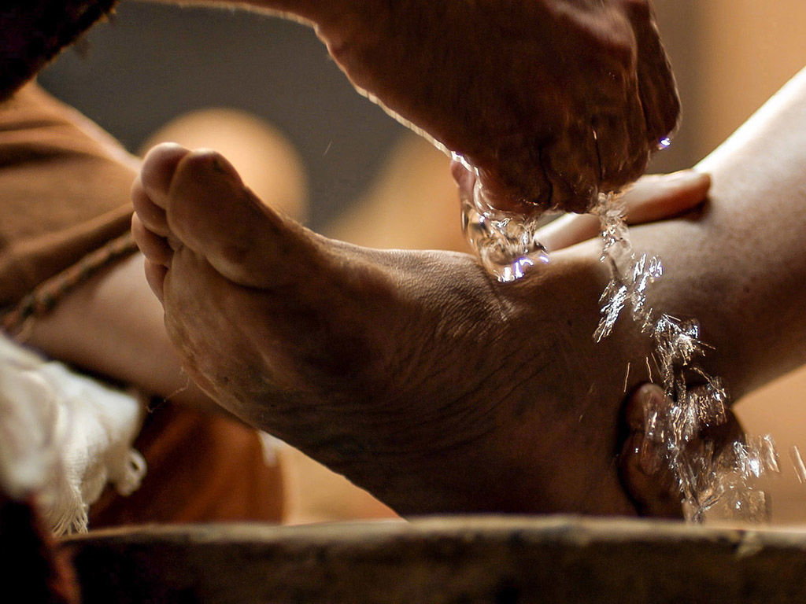
Jesus is NOT focussed on Himself
At the Passover meal?
Love characterises chapters 13-17
Jesus wants to show the full extent of His love for the Father in total obedience and for them in total sacrifice
But He refuses to be a martyr

Slide 4
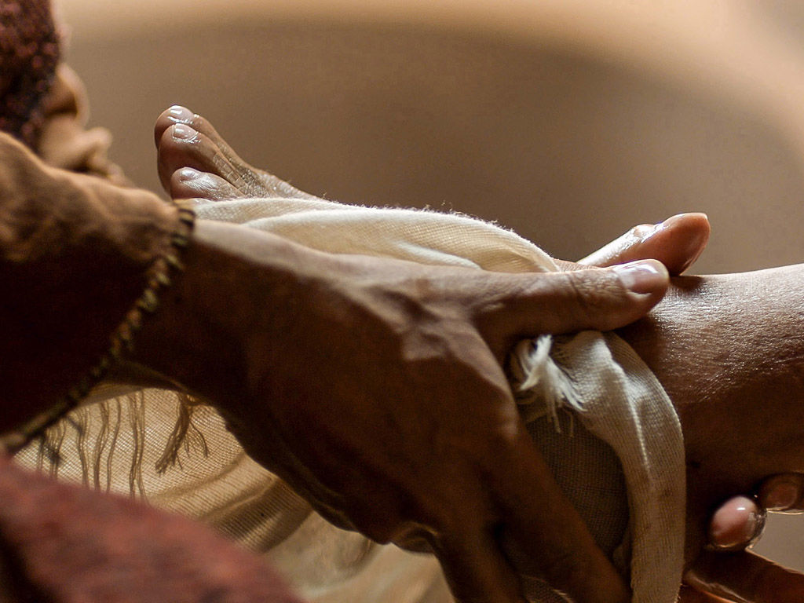
The blindingly obvious lessons
Jesus sometimes does things without telling us
Jesus sometimes does things without explaining why
Jesus calls for our trust, faith and co-operation
Christians are called to imitate the attitude as well as the behaviour of Jesus

Slide 5
The less obvious observations
Not understanding does not exclude our inclusion
Jumping to the wrong conclusions is not a crime against the faith
You will understand in the end
It will not just be at the superficial level

Slide 6
The washing of the disciples’ feet
This event is one of His priorities in the last couple of days of Jesus’ life
It’s an example of serving (17) and a lesson about ongoing grace and forgiveness
And with that He conquers each heart with His love

