Slide 1
Loving Prayer? Why prayer works……or not!
Romans 8:26-39

Slide 2
Life can be cold, fearful, shifting and completely uncertain. Where is God then? What is he doing then? What can we do then?
In the face of the many problems our world faces, we feel weak and ineffective. This becomes especially acute when suffering touches us and/or our families. Utter weakness. How should we respond?

Slide 3
“..the love of God that is in Christ Jesus”
Keep prayer in focus (26)
Holding onto God ourselves. (14)
God knows us and holds us in love (15,28)
Pray in petition and intercession. (26).
God has chosen prayer as one way of seeing his will done on earth.
Let the Spirit help! (26)

Slide 4
“..the love of God that is in Christ Jesus”
Keep love in focus. (39)
It’s God’s committed love (32) He didn’t withhold his Son from us to save us.
It’s God’s resurrecting love (34). Here is power. Life overcoming death itself.

Slide 5
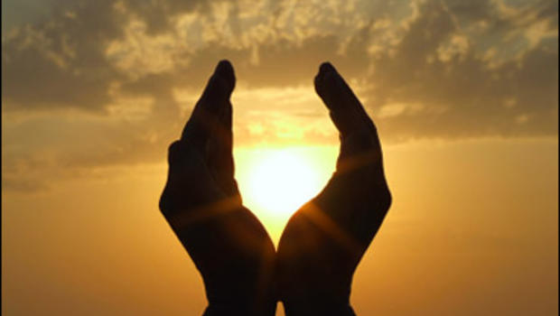
“Suffering and persecution are not mere evils which Christians must expect and endure as best they can; they are the scene of the overwhelming victory which Christians are winning through Christ” (C.K.Barrett)

Slide 6
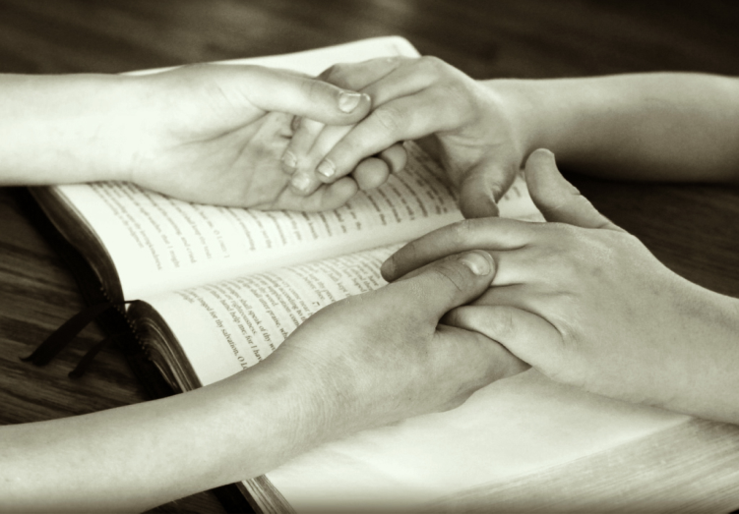
“..the love of God that is in Christ Jesus”
Keep love in focus. (39)
It’s God’s committed love (32) He didn’t withhold his Son from us to save us.
It’s God’s resurrecting love (34). Here is power. Life overcoming death itself.
It’s Jesus’ loving prayer (34). In our struggling prayer, we are not alone!

Slide 7
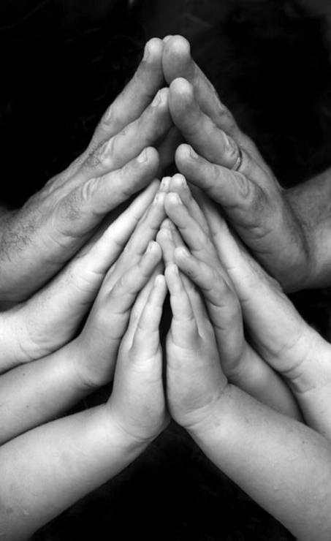
“..the love of God that is in Christ Jesus”
Effective prayer is loving prayer.
Prayer that is the heart of our loving relationship with God in Christ.
Prayer that arises out of love for us and others.
Prayer inspired by love.

Slide 8
“Intercessory prayer is spiritual defiance of what is in the name of what God has promised. Intercession visualizes an alternative future to the one apparently fated by the momentum of current forces. Prayer infuses the air of a time yet to be into the suffocating atmosphere of the present.” (Walter Wink. “The Powers that Be” p.184)

Slide 9
REVIEW OF THE DAY
I come before the Lord, who looks upon me with love.
I ask to see the most important moments of the day.
I let the day unfold before me in my imagination,
letting the times that meant most arise for me naturally.
When have I felt most joy? Or when have I felt loving or most loved?
When have I felt faith, or hope, or peace? Or just felt most alive?
For what moment today am I most grateful?
Were there moments of sadness, of bitterness, of feeling lost?
Or unfree, dishonest or fearful moments?
For what moment today am I least grateful?
For the happy times I give God thanks.
For the sad or loveless times I ask for healing and forgiveness.
In all that happened God was with me and grace was available to me.
I ask for an awareness of God's loving presence in my life tomorrow.

