Slide 1
Sealing the Covenant
5. Deuteronomy 28:15-68 Heed the warnings

Slide 2
Keeping promises
God is a promise keeper!

Slide 3
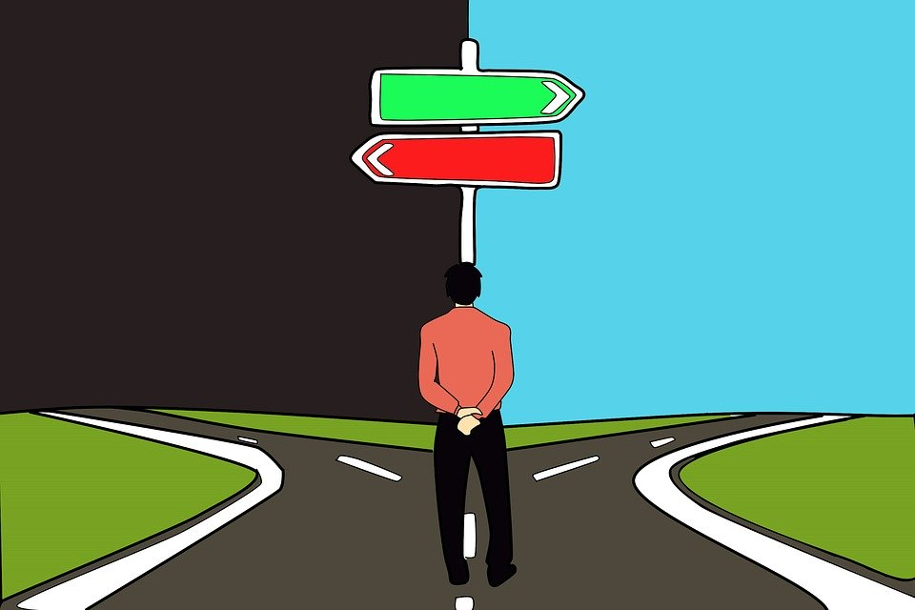
Deuteronomy 28:15-68
Hard to read!
Used wrongly to condemn the world
They’re warnings typical of Ancient Treaties
List of 10 stark alternatives for God’s people
These are the consequences for God’s people who break the deal after they have made it
It shows the seriousness of their decision to become God’s people
The book has already warned God’s people “when you eat and are satisfied, be careful that you do not forget the Lord” (6:11,12)
“Don’t let this happen to you”

Slide 4
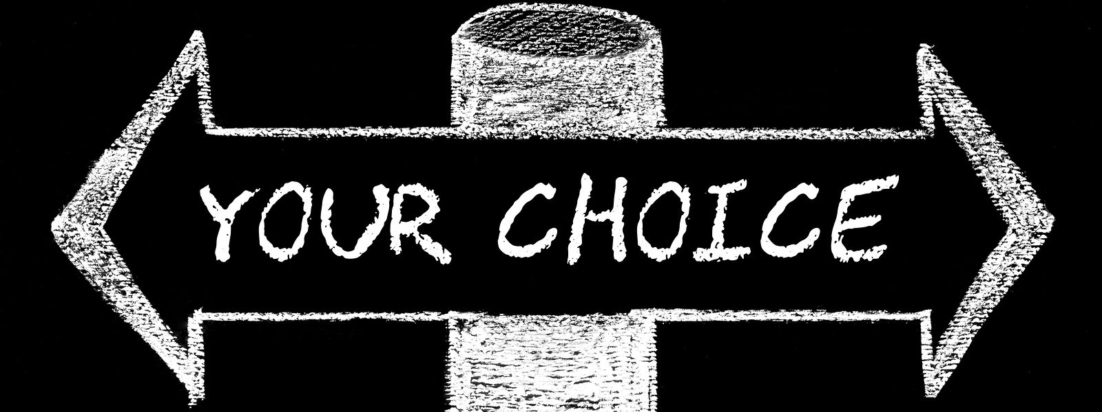
God will judge according to your response
The judgment is predicted
This warning shows the mercy of God
He wants you to understand the consequences of your actions and your choices
The judgment is extensive
God will not change His mind because people offered to appease Him with a sacrifice
The judgment is pervasive
Every aspect of life will be touched
You don’t want to go there
The only way out of this is repentance
The judgement is in the context of the alternatives
God’s curses were a direct challenge to those who abandoned Him and followed Baal

Slide 5
God’s judgment is avoidable
These things would happen for a reason
Disobedience
Ingratitude
Irreverence
It led to:
Confusion and restriction
Feeling isolated and alone
Powerlessness in difficulties
Feeling oppressed and uncertain
The passage is shouting “DON’T GO DOWN THIS ROAD”
The NT tells us similar things

Slide 6
If you’re there already…
You may not be!
Remember Job
But you may be…
Change direction and seek the God of Grace

