Slide 1
The Leading of the Spirit
17. Inspired to speak their language Acts 17:16-34

Slide 2
How do you talk to people about your faith?
Do you always start with the Bible?

Slide 3
Paul’s example
He engaged with those that did accept the Bible
He went to the synagogue and argued for Jesus and the resurrection there
He went to those who accepted Judaism, the God-fearing Greeks, and argued for Him with them
He saw people positively
It’s a shame all that devotion, love and sacrifice had the wrong focus
He engaged with those who did NOT accept the Bible
Their initial answer was a warning to Paul

Slide 4
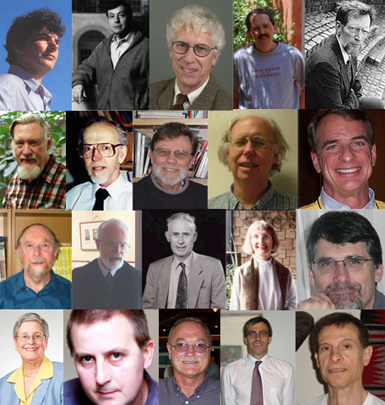
There’s Good News for philosophers
There is a personal creator
Human beings have dignity
There is hope
People do have a place and a path to follow
Judgement will come
Through a resurrected Christ
Repentance is needed
You cannot find this at the end of your rainbow!

Slide 5
Evangelism in the real world
Starts where they are
Speaks of their unknown
Speaks of the God you know
A God who doesn’t leave things to chance
A God who oversees the world and the placing of people on the earth
A God who offers choice and free will

Slide 6
God allows people free thought
He is not the inflator or deflator of egos, He is the Creator God that we should seek to find our true selves and our true value

Slide 7
God wants you to seek Him
He ordered your world so that you would seek Him
If there were too much blessing you would have said ‘it was good fortune/luck’
If there were too many bad things you would have said ‘God is distant and remote and doesn’t care’

Slide 8
God wants you to reach out to Him
It’s tough being you
But with God’s help you can rise to glory

Slide 9
God wants you to find Him
He wants you to discover the joy of being in His presence and feeling clean and loved and wanted and needed and special

Slide 10
God loves people
He wants your friends and family to find Him too
Christ is the way

