Slide 1
The Leading of the Spirit
9. Inspiration to do the inexplicable
Acts 8:26-40

Slide 2
Being led by the Spirit
On big occasions
At the personal level
Being led by the Spirit is not just about moral dilemmas and big decisions
Sometimes it’s trying to decide if it’s just you or if it’s a prompting of the Spirit
When things turned out great for the kingdom the story is retold in hindsight and in the language of faith
A kind of God perspective

Slide 3
God guides His people
Through others
Through the inward witness of the Holy Spirit
Through the word/the scriptures
These do not give different messages
God has great timing!

Slide 4
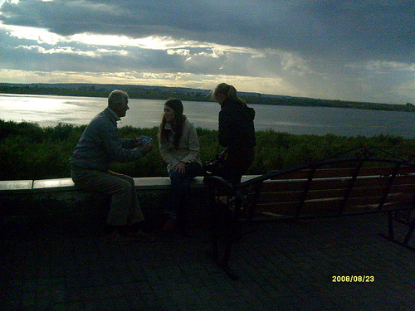
God uses His people to help others come to faith
By meeting
At the end of the encounter the Ethiopian went on rejoicing in his new-found faith & Philip was fired up to do even more sharing of the good news
By talking
The conversation was led by the Ethiopian
By helping

Slide 5
God does NOT want Christians dependent on others
God wants Christians inter-dependent
Each doing their own jobs in their own place according to the faith that He gives them

