Slide 1
Adapting to get from here to there
Deuteronomy 8:1-20
God’s word for a time of change

Slide 2
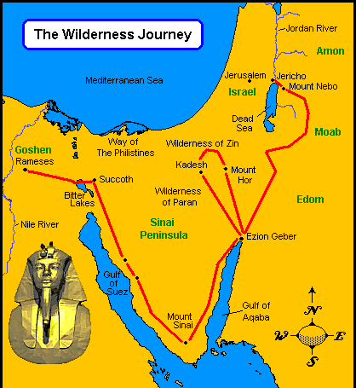
Background
The Israelites are on the edge of the Promised Land after being rescued from slavery and wandering around the wilderness for 40 years
Their time in the wilderness was not a wasted time

Slide 3
Remember and Keep
At the heart of it all:
The fourth commandment (Ex 20) about the Sabbath Day
All the commandments
Every Jewish home
Both are needed!

Slide 5
Remember
Who you are and what you’ve been through
Remember God’s fatherly training (1-6)
Who helped you and how you got through
What you have been given
Remember God’s generous provision (7-16)
You are precious to Him and you are called to be His child
Remember God’s standards for God’s Kingdom (17-20)
Some things can only be learned when you’re in trouble!

Slide 6
Keep
Is letting that rescue change us
Is saying ‘Your ways are best’ and ‘Your will is right’ to God
Is demonstrating that the Kingdom of God is not like the world

Slide 7
If you are God’s child, He disciplines you (5)
God’s path is easy to see but difficult to stay on
God wants you to remember Him
God wants you to remember who you are
God wants you to remember the past, so you can change your future
God now gives you the full resources of heaven to be a child of the kingdom in the world He created

