Slide 1
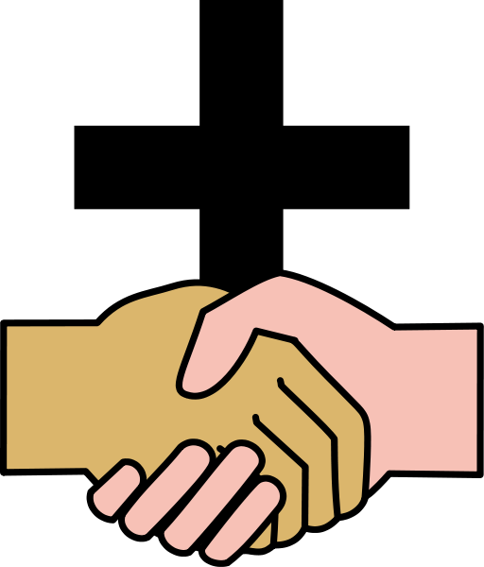
Applying the Covenant
12. Deuteronomy 26:1-19 What happens when we worship?

Slide 2
Deuteronomy 26
The final part of the section of applying the covenant
Gives some of the most practical guidelines to the response God is looking for from His people
It is worship without guilt

Slide 3
Worship that is pleasing to God
Remembers the journey with humility
Acknowledges His generosity (1-4)
Recalls His faithfulness (5-9)
Honours His uniqueness (10)
Obeys His commands (11-15)
Affirms His truth (16-19)
Brings gifts of thanksgiving
First-fruits were just that
Tithes were giving 1/10 of everything to God
Is open to God’s leading today

Slide 4
God calls for personal worship
I declare what God has done
I declare where I fit in
I bring gifts of appreciation
I have not earned this, God has been gracious to me
I share with the poor and the priest
To the poor: I was once where you are and I want you to rise in God’s grace
To the priest: I acknowledge that God speaks through you and I respect your calling

Slide 5
God wants to honour you
You are secure
You are HIS people
You are loved
He wants to set you in praise
He wants to show you to the world
You are privileged
He wants to honour you above other people groups
You are dedicated
He wants to set you apart as a holy people
How much more are we secure, loved, privileged and set apart in Christ?

Slide 6
