Slide 1
What is this?

Slide 2
God speaks your language

Slide 3
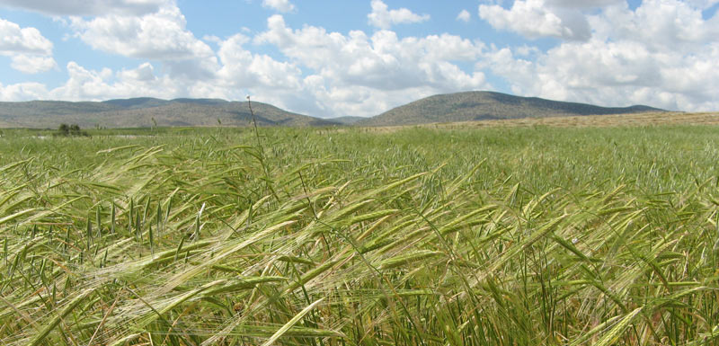
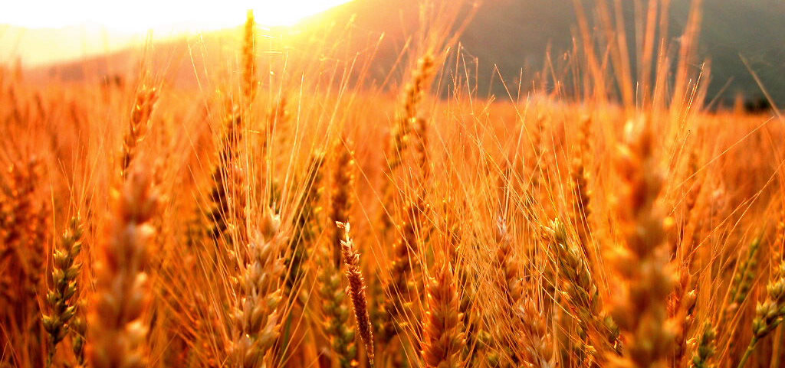
Seven Weeks Later
(Leviticus 23:15)
Spring
Start of Barley Harvest
Passover Festival
Associated with Israel’s redemption from slavery in Egypt
A time of faith: varied weather ahead
Easter: Jesus’ death and resurrection
Early Summer
Start of Wheat Harvest
Shavuot Festival (Pentecost in Greek)
Associated with the giving of the Law at Sinai
A time to thank God for the grain harvest and pray for the coming summer fruits
Pentecost: the Holy Spirit given to the believers

Slide 4
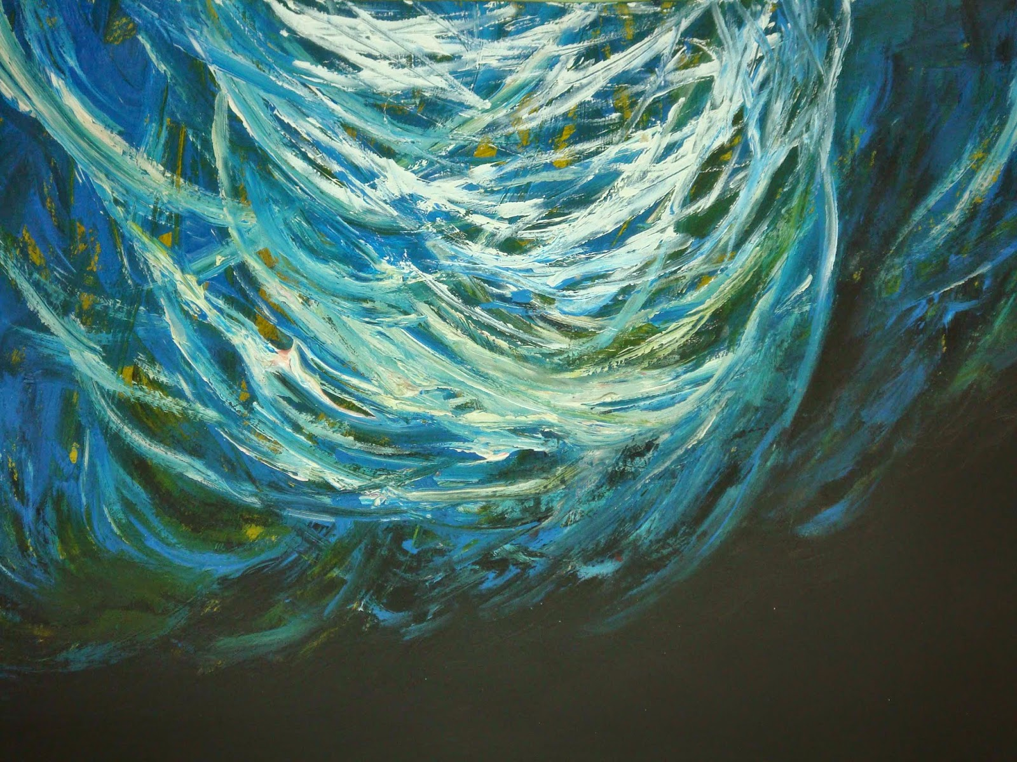
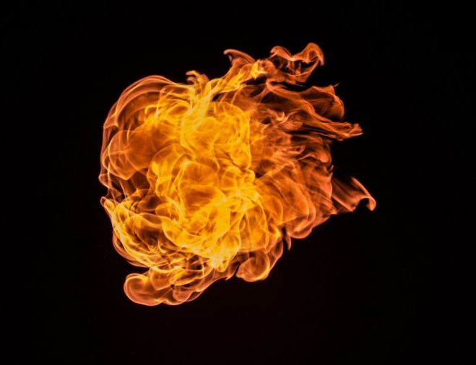

Slide 6
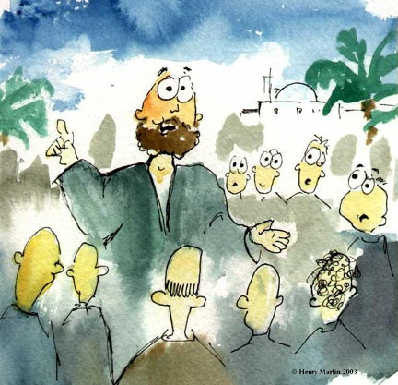
What peter preached
The long-promised messianic age has dawned
This happened through Jesus’ ministry, death and resurrection
Jesus has been exalted to God’s right hand
The Holy Spirit’s activity is the sign of Christ’s power and glory
Forgiveness and the Spirit are offered to those that repent

Slide 7
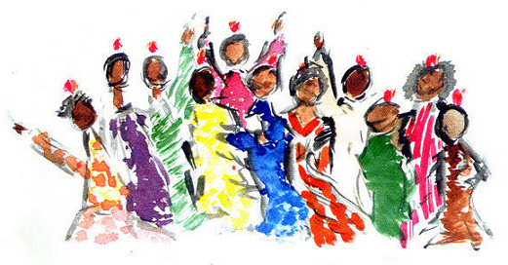
Spirit-filled churches
Obey Jesus’ teachings
Show love to one another, supporting each other, helping the poor, caring and sharing
Worship with joy and reverence
Reach out in continuous evangelism, not absorbed in their own affairs but engaged with the world around them

Slide 8
Love languages
Time
Gifts
Acts of Service
Touch
Words of Affirmation

