Slide 1
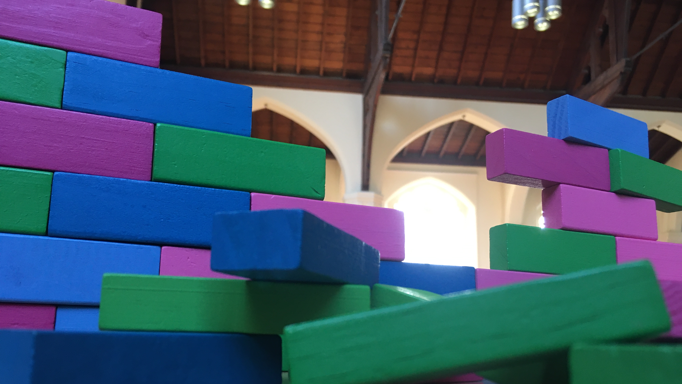
Together in Moving On
Nehemiah 3 & 4

Slide 2
Context
Exiled, dispersed and afraid to move on
For I know the plans I have for you,’ declares the Lord, ‘plans to prosper you and not to harm you, plans to give you hope and a future. Jeremiah 29:11
With God, the future is never hopeless

Slide 3
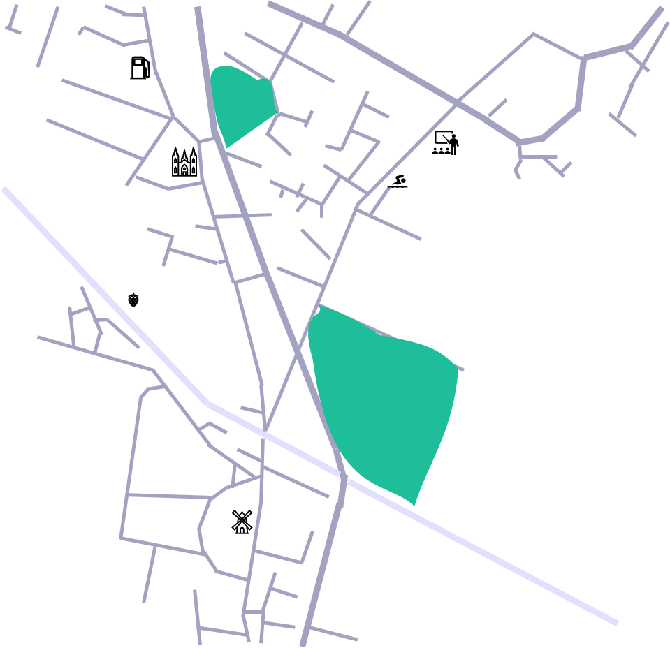
Any parallels?
We are emerging from various exiles
Are we afraid to move forward?
How do we support each other?

Slide 4
Are we together?
Nehemiah 3
A mixed bunch of amateurs!
Some refused to join in
Acknowledging pain and limits was part of the story
Praising God gave them courage
The task was achievable

Slide 6
God’s Mission
‘Missio Dei’ is the mission of God
God is already active in the world and sends us out into his mission field
God wants to restore and rebuild
What has God invited you to do?

Slide 7
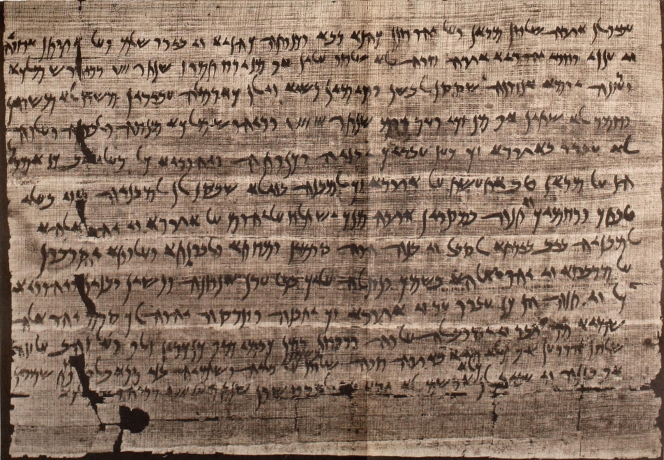
What about resistance?
External and internal opposition
For our struggle is not against flesh and blood, but against the rulers, against the authorities, against the powers of this dark world and against the spiritual forces of evil in the heavenly realms Ephesians 6:13
A letter from the Elephantine Papyri mentioning governor Sanballat, 407BC, public domain (Wikipedia)

Slide 8
How do we respond well?
Prayer
Planning
Practical work
Personal encouragement

Slide 9
God has the power!
“Remember the Lord, who is great and awesome!”
Nehemiah 4:14
“the joy of the Lord is your strength”
Nehemiah 8:10

