Slide 1
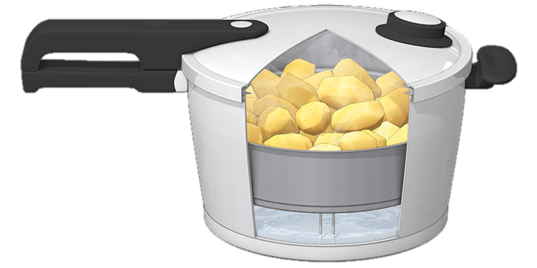
Faith in the Pressure Cooker
The Letter Of James
3 Your mind in the battleground
1:12-19
Faith

Slide 2
The pressure cooker
The pressure cooker is the place where things get done quickly
It’s where you feel the impact of every decision and you don’t have the luxury of time
It’s where the difference between undercooked, perfect and overcooked is measured in seconds and blowing a gasket can happen often

Slide 3
Faith

Slide 4
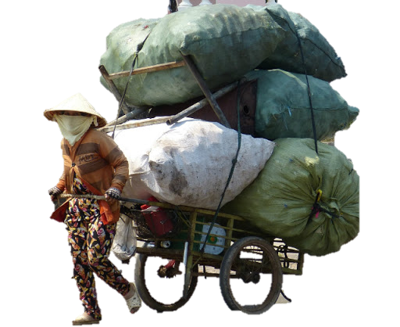
God wants you to gain eternal glory
He has opened the door
He has paved the way
He has removed the obstacles
He has given you everything you need
He has invited you in
But on your way God will challenge you about the stuff you are carrying and your view of God

Slide 5
God wants you to win the crown of life
The crown is not for everyone
A crown for those qualified to receive it
A crown only given to winners
The crown of life was for winning as a human being in God’s eyes
You becoming all that God intended you to be when He first imagined you

Slide 6
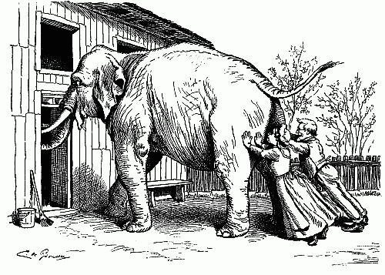
Our God is different
He is Pure, Good and beyond emotion
The God of heaven is not insecure
He doesn’t allow luggage in heaven
This lockdown is a test/trial to refine your character
Your desires would like to steer you to a more comfortable path that allows you to keep your luggage
Your luggage will not fit through the door to glory

Slide 7
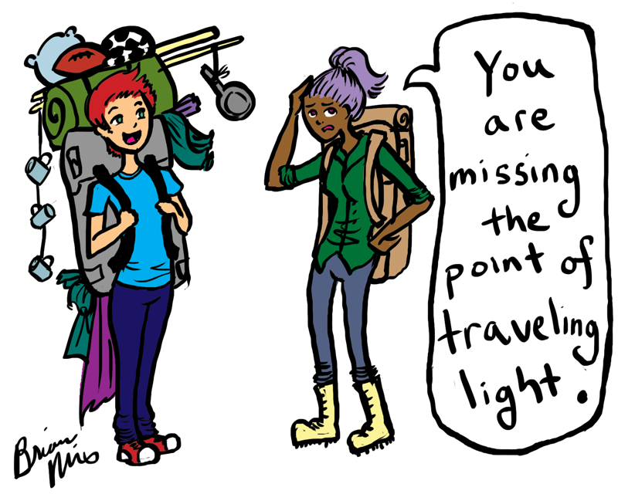
This week’s challenge
Now that lockdown is coming to the end ‘what is really essential to a life well lived?’
How has the lockdown changed your views of what’s important and what’s vital?

