Slide 1
The Focused Jesus
Jesus’ ministry in the last week of His mortal life
John 12:1-19:42

Slide 2
Communicating with God
Prayer part of the whole section
One of 3 recorded prayers in John’s gospel
Prayer based on knowledge of God
Because I know this… I pray that…
Gethsemane prayer?

Slide 3
God a Father
Jesus prays for Himself
You are MY Father
Because of this I know that…
Because of that my prayer is…
Glorify me so that I can glorify you
Give back to me what I had with you before I left glory for this task

Slide 4
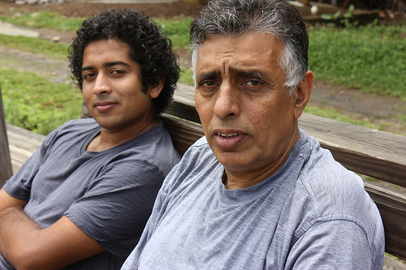
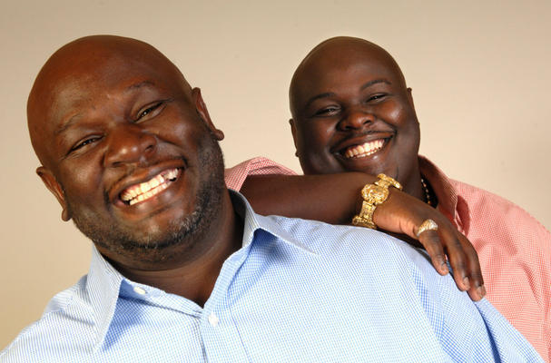
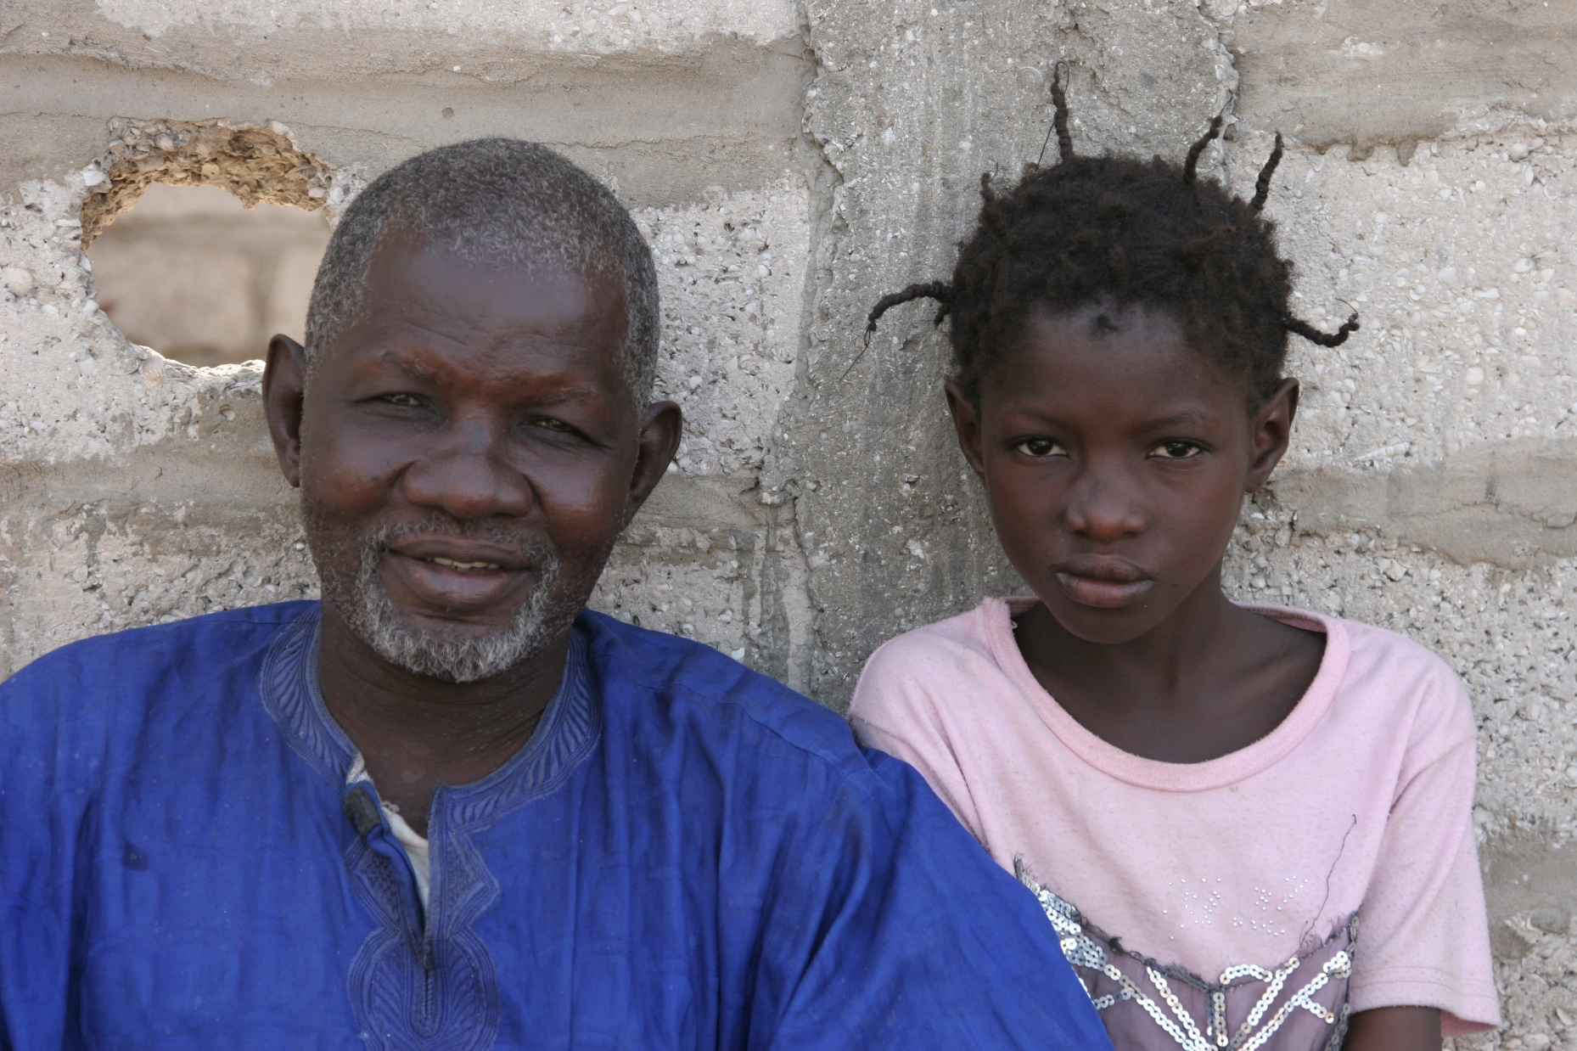
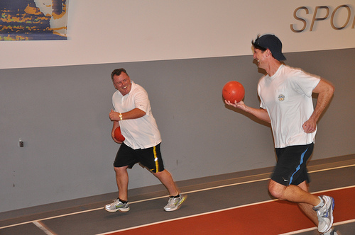
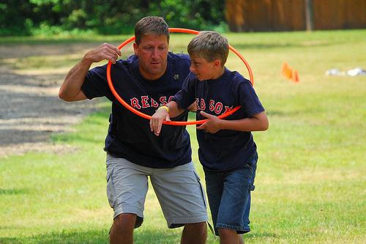
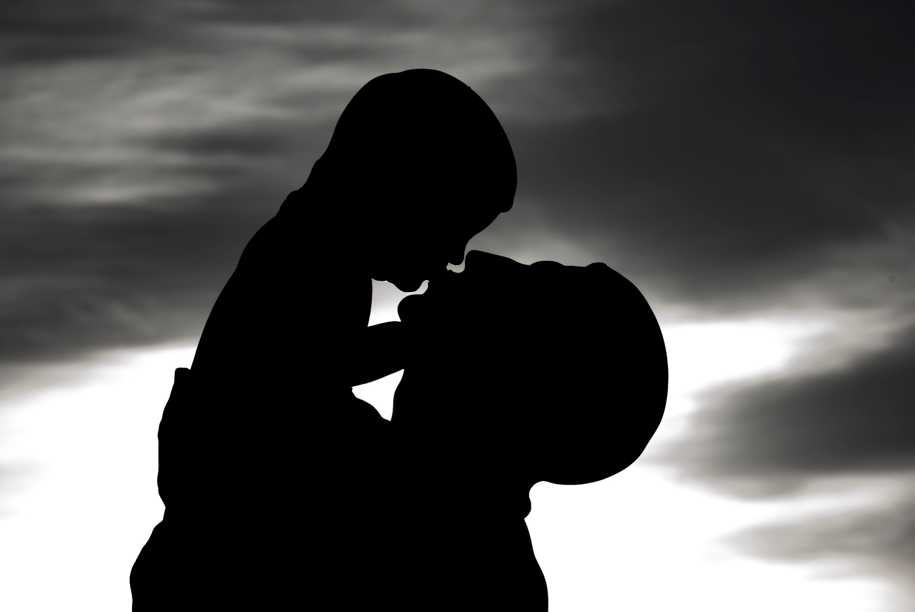
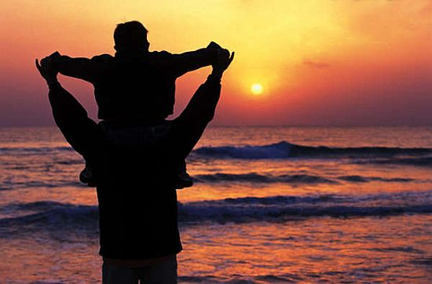
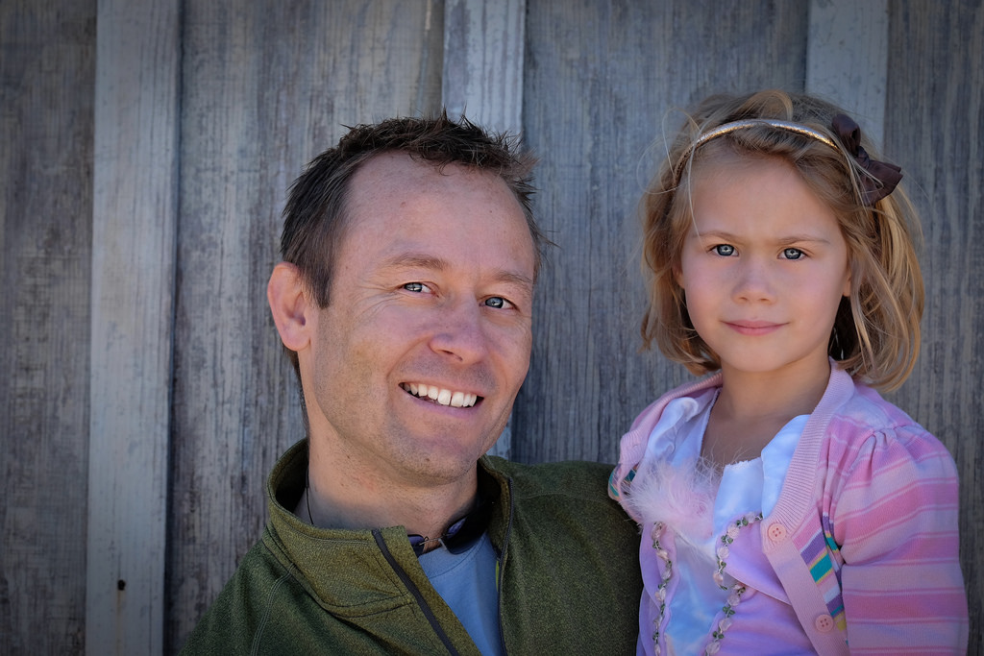
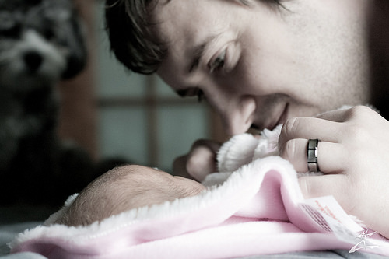
God a Father

Slide 5
God is Holy
Jesus prays for the 11
Holy Father
Because I know this…
I pray that…
You protect them so that they may be one
You sanctify them by truth that comes from Your word

Slide 6
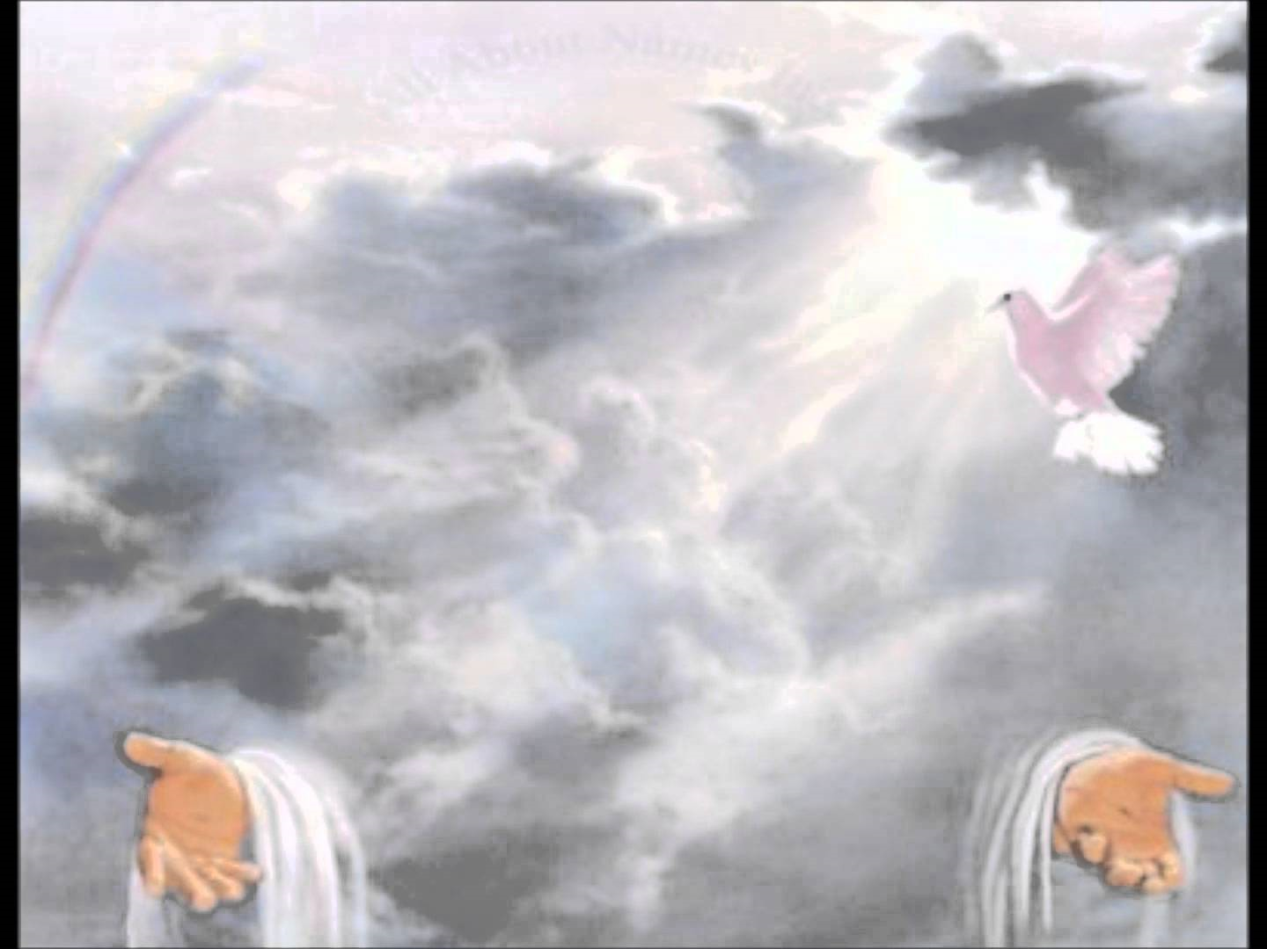
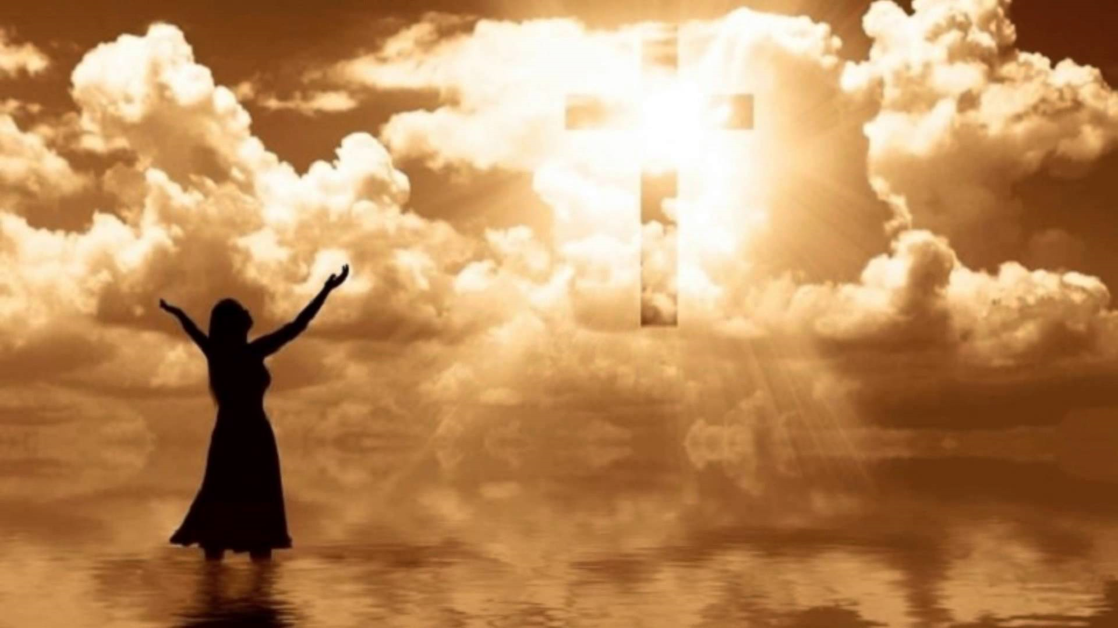
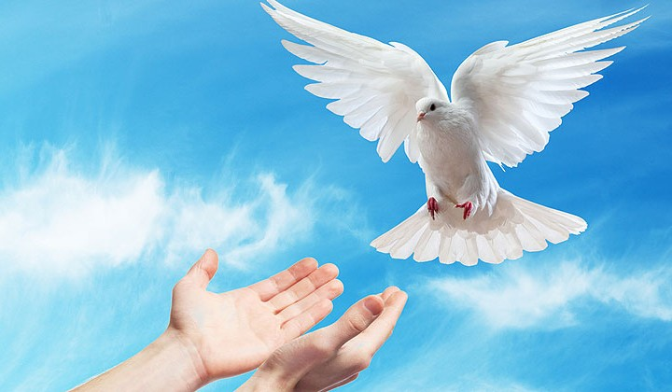
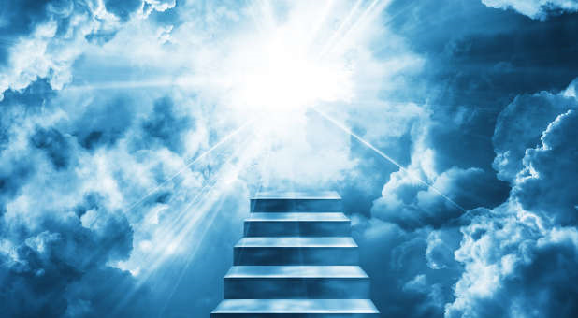
God is Holy

Slide 7
God is Righteous
Jesus prays for the church to come
Righteous Father
Because I know this…
I pray that…
They may join Me to see My glory
They may be one: United in Righteousness
Righteousness is staying within the bounds of a relationship or a covenant

Slide 8
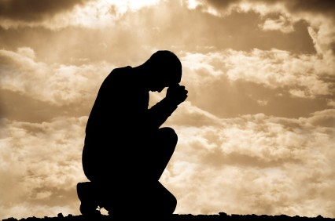
God is righteous
Righteousness is staying within the bounds of a relationship or covenant
RIGHTEOUS
MEANS
The prayer of a righteous person is powerful and effective James 5:16
DOING
RIGHT

