Slide 1
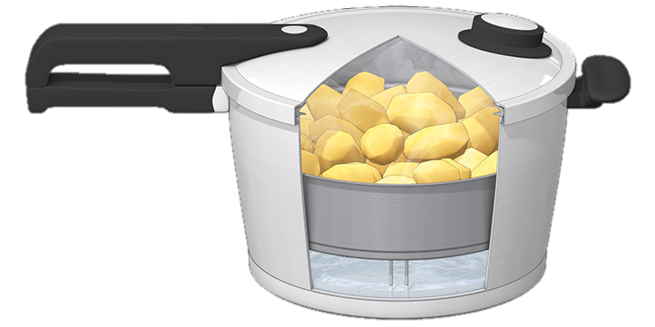
Faith in the Pressure Cooker
The Letter Of James
6 Your impartiality brings life
2:1-7
Faith

Slide 2
The pressure cooker
The pressure cooker is the place where things get done quickly
It’s where you feel the impact of every decision and you don’t have the luxury of time
It’s where the difference between undercooked, perfect and overcooked is measured in seconds and blowing a gasket can happen often

Slide 3
Pentecost
The day of the church’s enabling
The day the OT pattern of engaging with God changed
It raises our hope
It also raises our responsibility before God

Slide 4
We are called to a better faith
The standard is Jesus’ faith
It’s the faith ‘of our Lord, Jesus Christ’ (2:2)
James is saying the outworking of your faith is measured against the faith Christ had when He walked on earth

Slide 5
Jesus’ faith
All people were treated equally
He saw the damaged image of God in each one
An image repairable by the grace of God He would supply through the cross
He still sees it today
When you express your faith do it like He did it

Slide 6
Faith is a process
On the day of Pentecost
It was anointed
Over the years it developed
The faith that showed partiality was a sub-standard faith for Christ’s followers
It’s still a sub-standard faith when colour, gender, age, wealth, attitude, values or behaviour block us from seeing the image of the living God in another person

Slide 7
Your faith should be becoming like the faith of Jesus
A faith that rose to obedience
A faith that saw a glorious future
A faith that witnessed the peace of God
This is the glorious faith God has His eyes set on for you
The faith for which He gives you the Holy Spirit
The faith that looks at people and sees eternal possibilities in Christ

Slide 8
Pentecost is here…
The anointing of God is for those who want their faith to be like the faith of Jesus
Is that you?

Slide 9
Faith

Slide 10
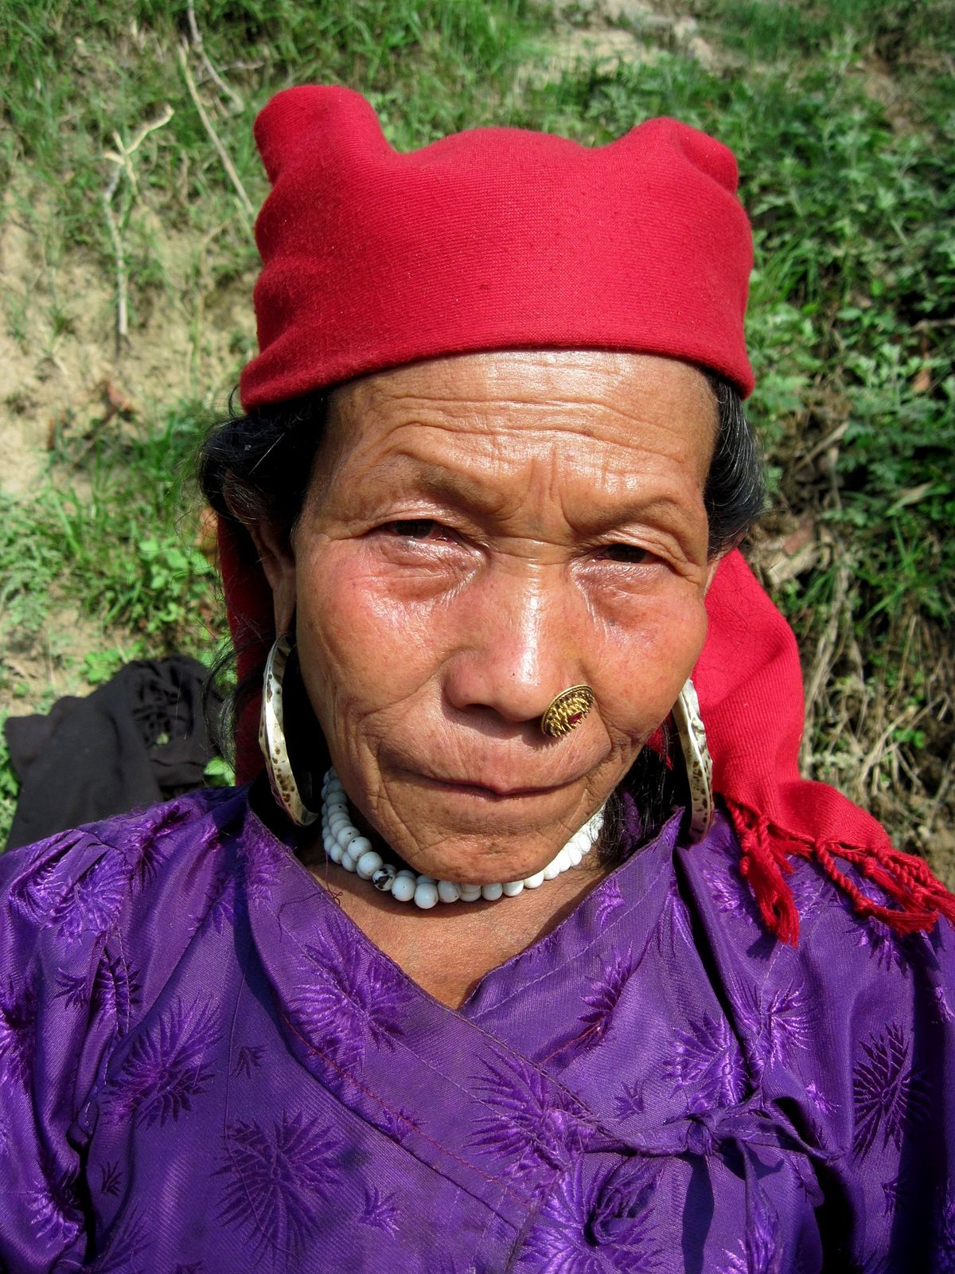
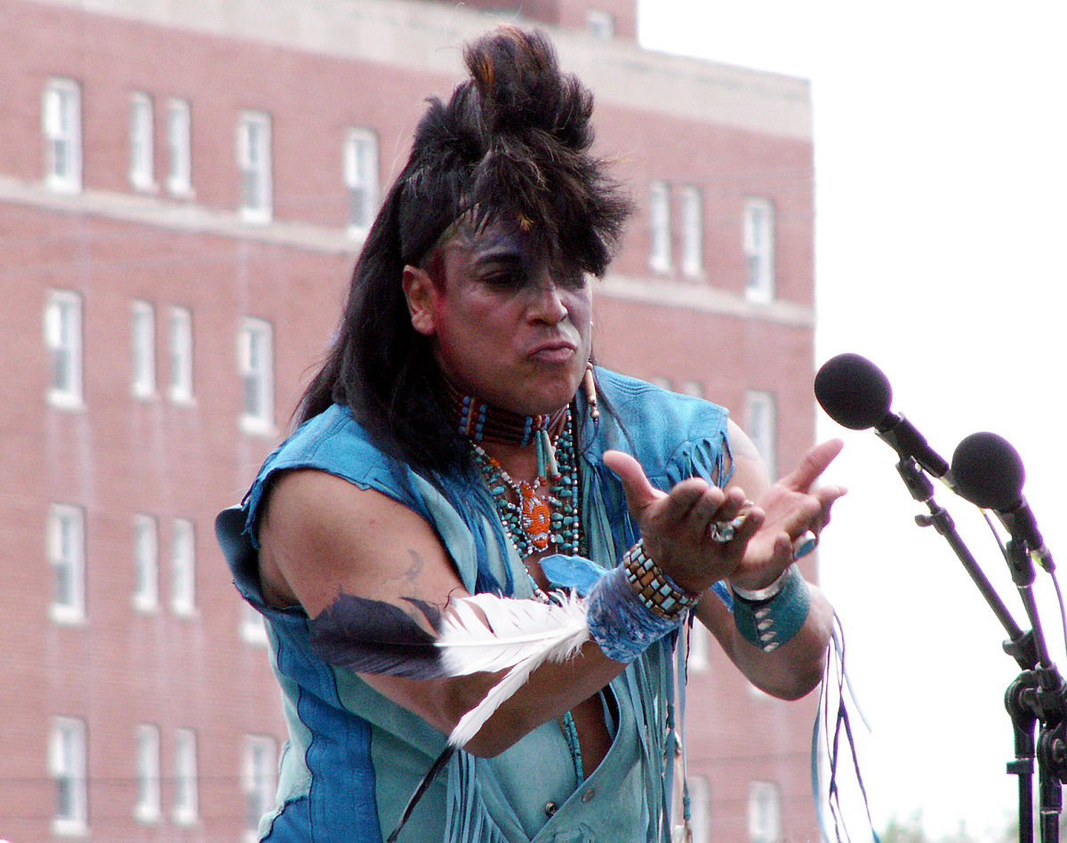
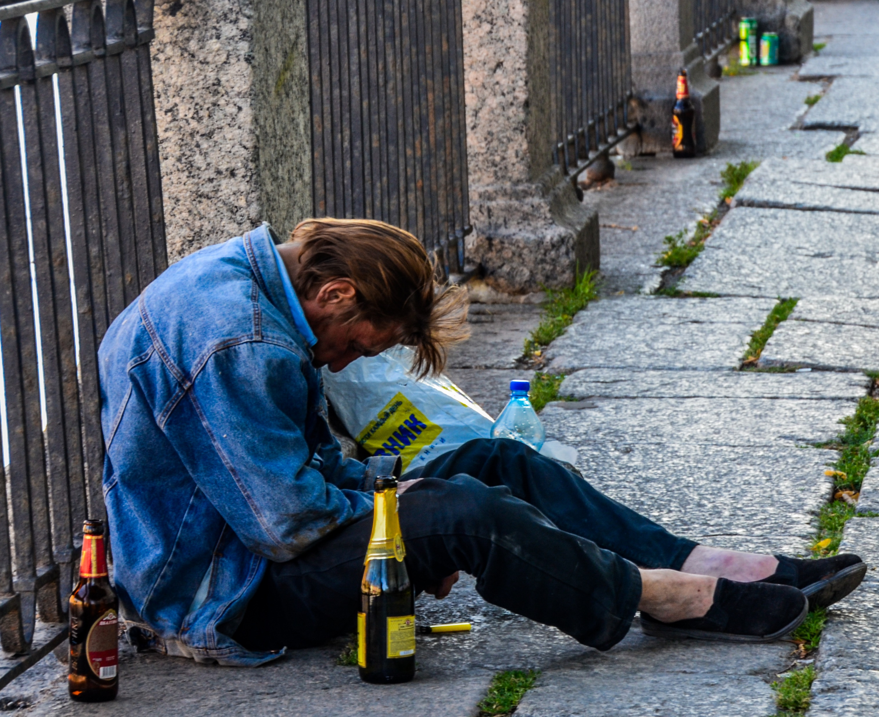
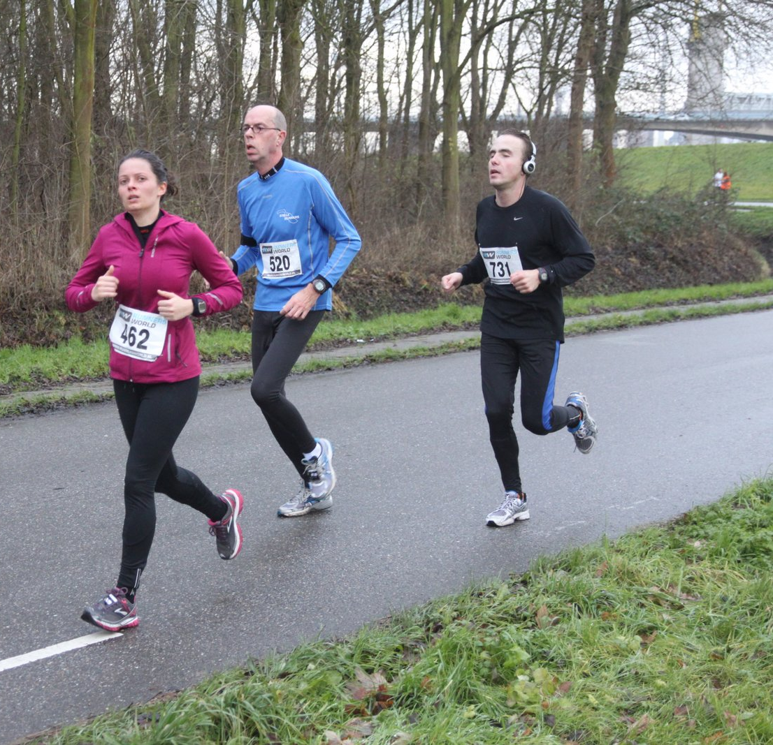
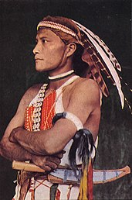
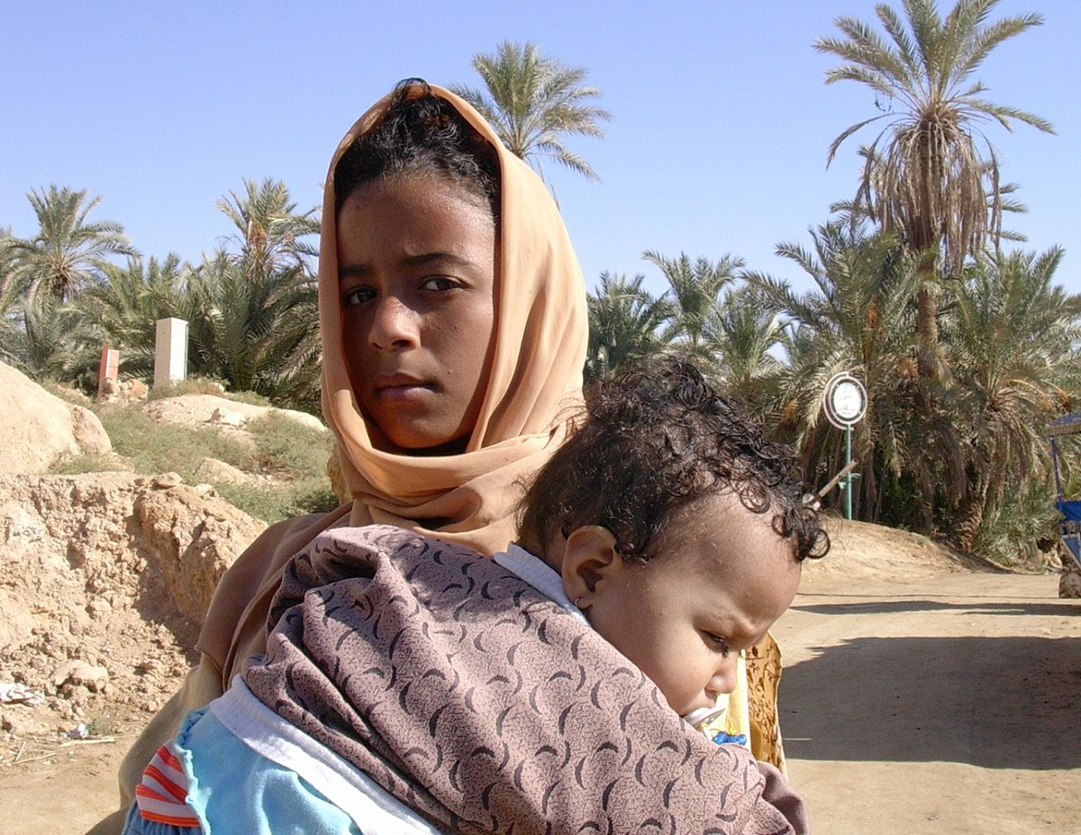
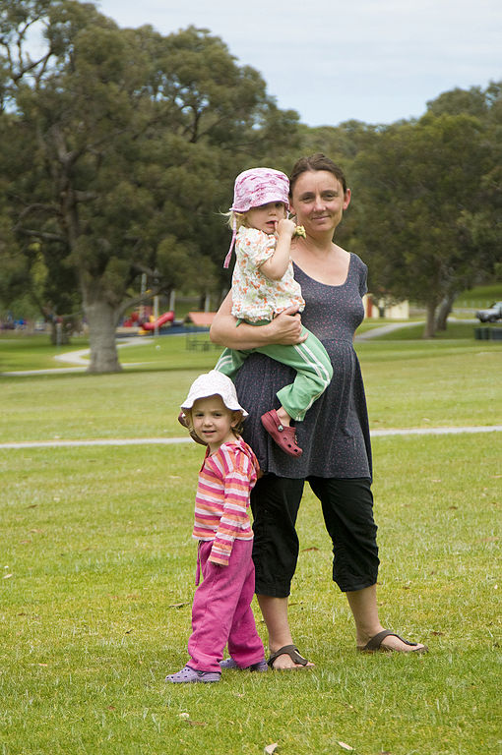
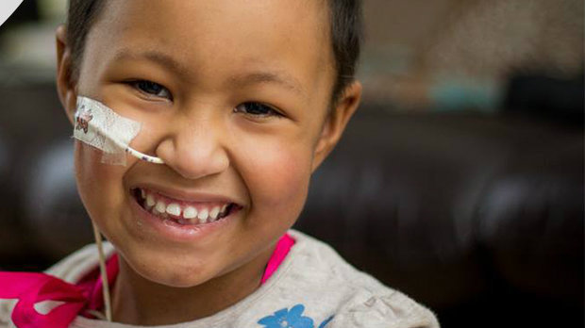
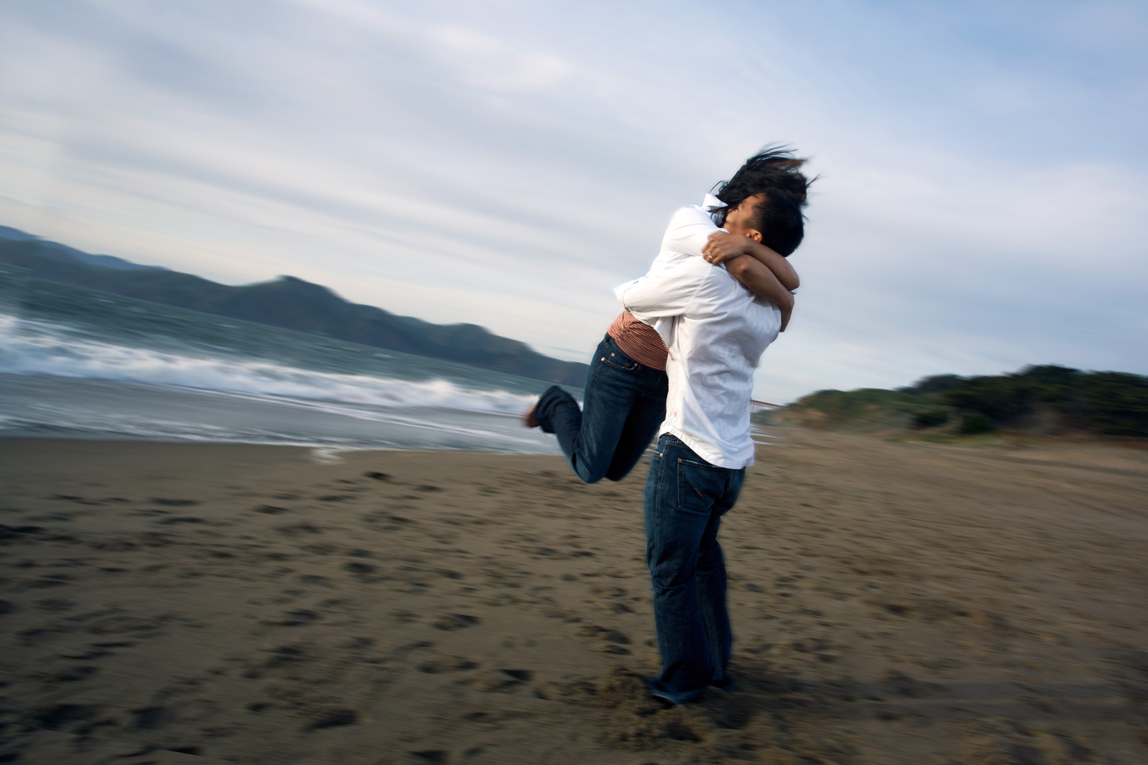
This week’s challenge
Do some people watching
Where is the image of God in them?
Seek to engage with that image

